Slide 1
Web Accessibility 無障礙網頁
Office of the Government Chief Information Officer
Digital Inclusion Division
數碼共融部
31 July 2013

Slide 2
Agenda
What is and Why Web Accessibility?
International Standards & Broad Principles
Web Accessibility Campaign
Web Accessibility Recognition Scheme

Slide 3
What is Web Accessibility?
Making web Content available for ALL
ALL people of the community
Including persons with disabilities (361,000 about 5.2% of total population)

Slide 4
Common Pitfalls in Web Accessibility
No alternatives for non-text content
Persons with visual impairment cannot perceive the image content
Alt = “Image 1”
Alt = “Officiating guests attending the Launch Ceremony of the Web Accessibility Recognition Scheme”
e.g. contain descriptive text alternative for image

Slide 5
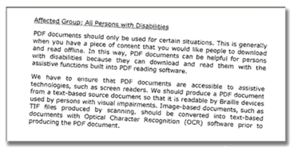
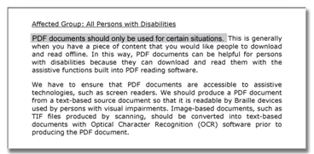
Common Pitfalls in Web Accessibility
Inaccessible PDF Files
Screen reader cannot read the content
Scanned Image not accessible
Text-based accessible PDF
e.g. use proper PDF generator to produce a PDF document from a text-based source document;
use Optical Character Recognition (OCR) software after scanning

Slide 6
Common Pitfalls in Web Accessibility
Text in Image is not accessible
Information is not conveyed to all
Text in image
Accessible text on a webpage
Avoid to convey information of wide public interest
If avoidable, provide descriptive text alternatives

Slide 7
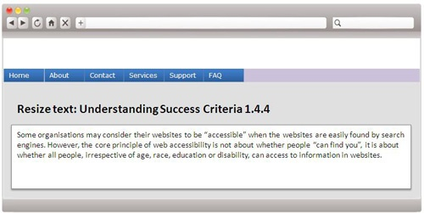
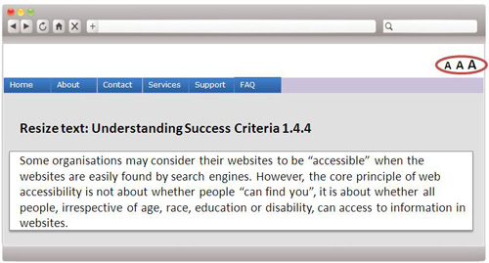
Common Pitfalls in Web Accessibility
Small font sizes
Persons with low vision cannot read the text
Cannot resize text
Can resize text
e.g. provide text resize function

Slide 8
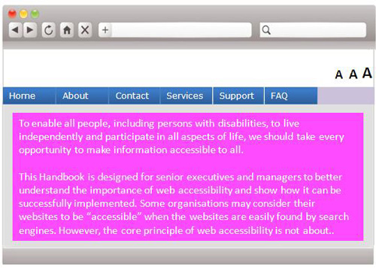
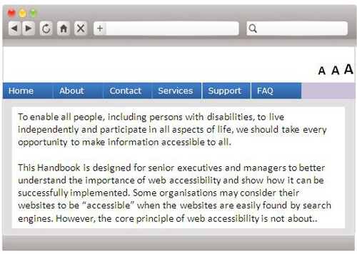
Common Pitfalls in Web Accessibility
Insufficient colour contrast
Persons with low vision have difficulty reading text that does not contrast with its background
Poor background contrast
Easier to read with higher contrast
e.g. provide sufficient contrast ratio

Slide 9
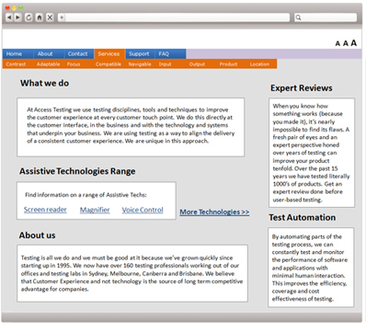
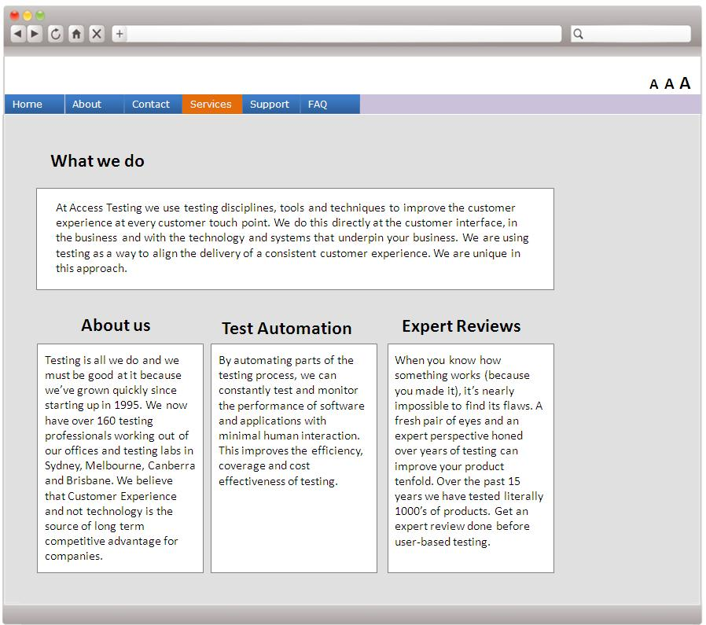
Common Pitfalls in Web Accessibility
Complicated website infrastructure
Persons with cognitive impairment have difficulty reading complex website structures
Complex structures
Simple structure
e.g. provide simpler and ordered website structure

Slide 10
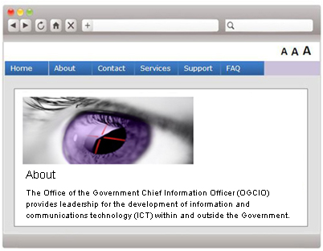
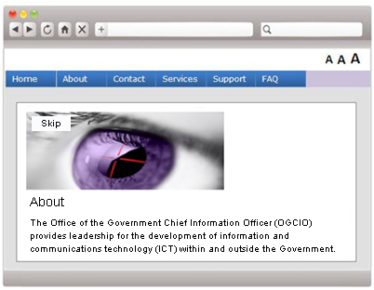
Common Pitfalls in Web Accessibility
Unable to skip inaccessible Adobe Flash and moving objects
Unable to skip
Skip function added
e.g. add a skip function

Slide 11
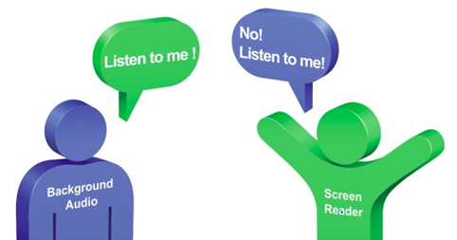
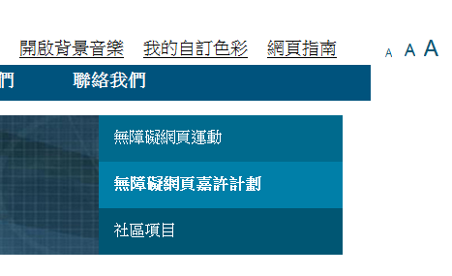
Common Pitfalls in Web Accessibility
8. Websites with background audio
Background audio plays automatically
Function to control background audio
e.g. add a function to control background audio

Slide 12
Common Pitfalls in Web Accessibility
9. Video without captions and audio description
Persons with visual or hearing impairments have difficulty to understand the video
e.g. provide captions and audio description

Slide 13
Why Web Accessibility?
Equal opportunities
United Nations’ Convention on the Rights of Persons with Disabilities 聯合國《殘疾人權利公約》
Disability Discrimination Ordinance 《殘疾歧視條例》(Cap 487) has created a legal duty for organisations to ensure their services are available to everyone
Corporate
Social
Responsibility
Social responsibility
Build positive corporate image
contribute to a more caring and inclusive society

Slide 14
Why Web Accessibility?
Search engine friendly
get more prominent ranking in search engine results
Widest possible reach-out
reach out to more online customers
Lower costs in the long term
easier to maintain which saves time and money in the long term
avoid unnecessary lawsuits

Slide 15
Legislation / Guideline
Country | Legislation / Guideline
Australia | Disability Discrimination Act (DDA) of 1992 WWW Access: DDA Advisory Notes The Guide to Minimum Website Standards
Canada | Canadian Human Rights Act of 1977 The Government of Canada Internet Guide
China | 國務院令第622號 -《無障礙環境建設條例》 《殘疾歧視條例》-（香港法例第487章） The Disability Discrimination Ordinance (DDO) Cap 487
United Kingdom | The Equality Act 2010 Formal investigation report on Web Accessibility
United States | American with Disability Act (ADA) Section 508 of the Rehabilitation Act Assistive Technology Act of 1998 Section 255 of the Telecommunications Act of 1996
European Union | Accessibility of Public Websites – Accessibility for PWDs: Council Resolutions, 2002

Slide 16
Legislation in China
《無障礙環境建設條例》
縣級以上人民政府發布重要政府信息和與殘疾人相關的信息，應為殘疾人提供語音和文字提示；
國家舉辦的考試(如：升學、職業資格等)，應當為視力殘疾人提供盲文試卷、電子試卷等；
設區的市級以上人民政府設立的電視台在播出電視節目時配備字幕，每周播放至少一次配播手語的新聞節目；

Slide 17
Legislation in China
設區的市級以上人民政府設立的公共圖書館應當開設視力殘疾人閱覽室；
殘疾人士組織的網站應當達到無障礙網站設計標準，設區的市級以上人民政府網站、政府公益活動網站，逐步達到無障礙網站設計標準。
http://www.gov.cn/zwgk/2012-07/10/content_2179864.htm

Slide 18
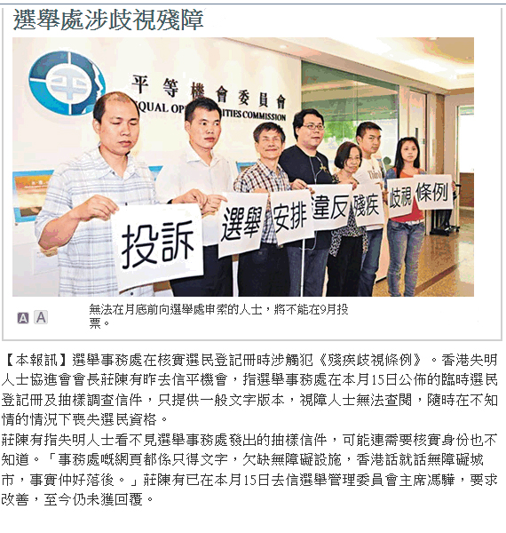
Local Complaint Cases
A NGO issued a press release in June 2012
Complained about inaccessible PDFs published on Government website
Source: Apple Daily Newspaper

Slide 19
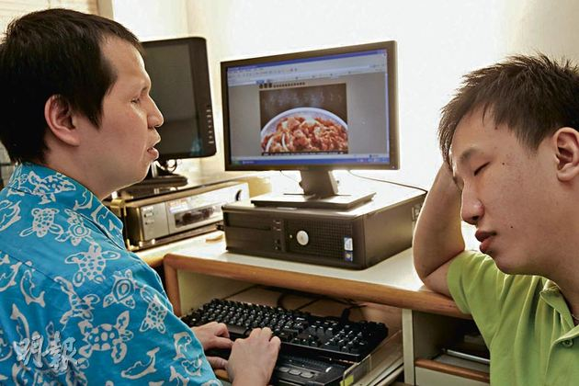
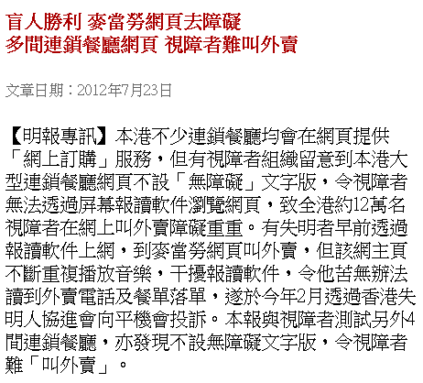
Local Complaint Cases
Complained about restaurant websites causing issues in online ordering
http://life.mingpao.com/cfm/basicref3b.cfm?File=20120723/braa02a/gma1.txt

Slide 20
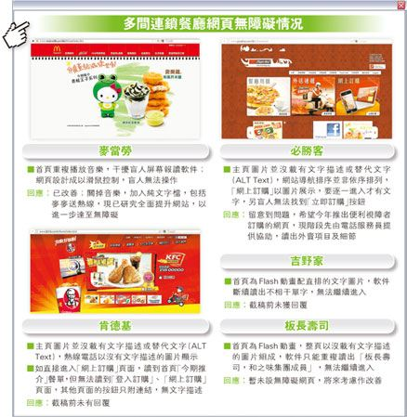
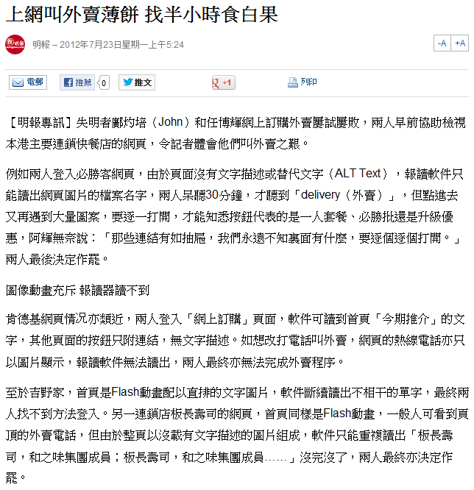
Local Complaint Cases
http://hk.news.yahoo.com

Slide 21
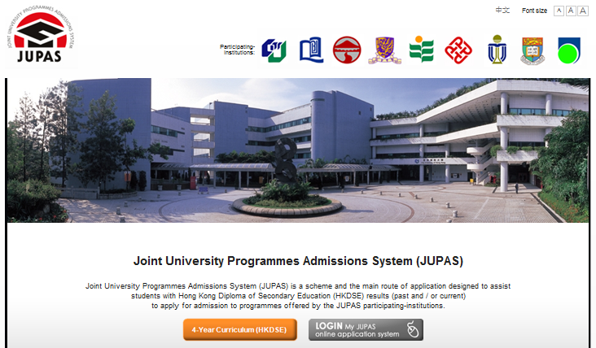
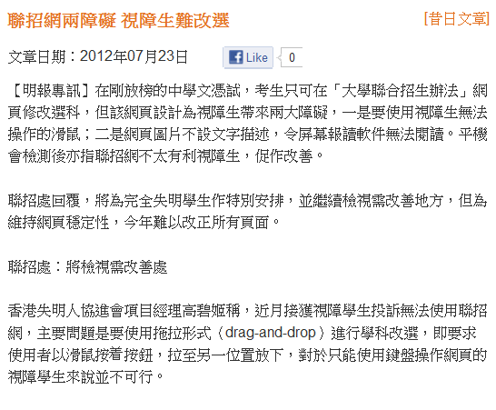
Local Complaint Cases
http://life.mingpao.com/htm/hkdse/cfm/news3.cfm?File=20120723/news/gma3.txt

Slide 22
Agenda
What is and Why Web Accessibility?
International Standards & Broad Principles
Web Accessibility Campaign
Web Accessibility Recognition Scheme

Slide 23
International Standards
World Wide Web Consortium (W3C) 萬維網聯盟consists of people from industries, disability organisations, governments, and research labs from around the world, develops strategies, guidelines, and resources to help make the web accessible to people with disabilities
Web Content Accessibility Guidelines (WCAG)
《無障礙網頁內容指引》have been developed over the years by W3C
Version 1.0 in 1999; version 2.0 in 2008
http://www.w3.org/WAI/

Slide 24
International Standards
The WCAG consist of four parts －
4 Principles 原則
12 Guidelines 指引
61 Success Criteria 成功準則
Many Techniques 技巧

Slide 25
WCAG - Principles
4 Principles
Content is Perceivable
User interface components and navigation are Operable
Information and operation are Understandable
Content is Robust enough to be interpreted reliably by a wide range of web browsers, assistive technologies, etc.

Slide 26
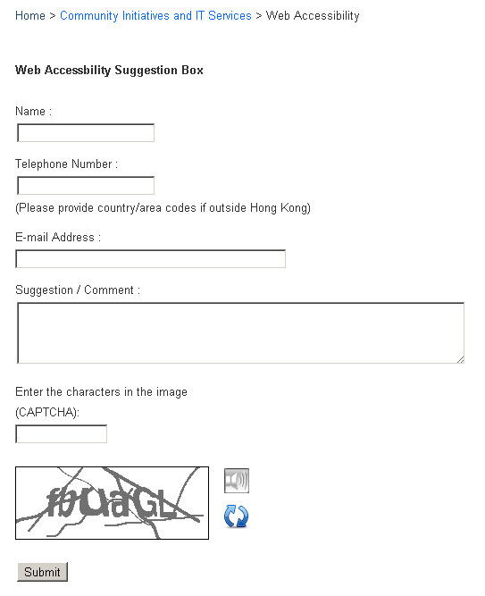
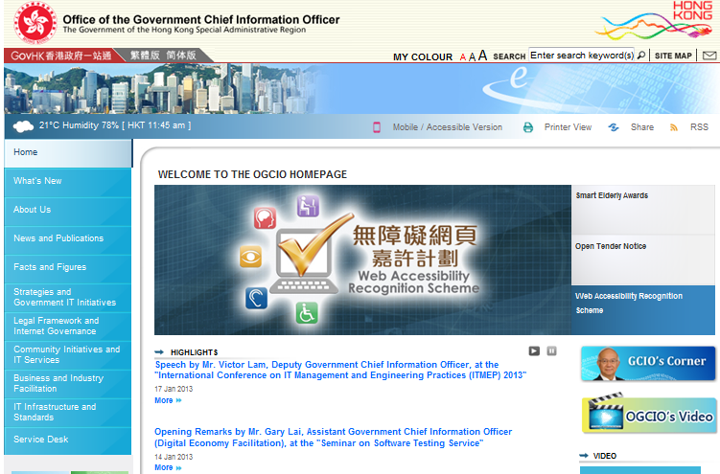
WCAG 2.0 - Principles
1 - Perceivable
Example - Audio CAPTCHA
2 - Operable
Example - Provide users enough time to read and use content
Provide Pause Function
Audio Support
www.ogcio.gov.hk

Slide 27
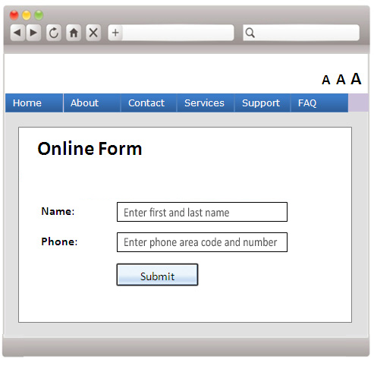
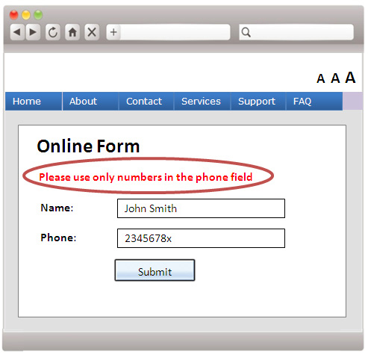
WCAG 2.0 - Principles
3 - Understandable
Example – Clear label with cue and error identification
4 - Robust
Compatibility with browsers
Input Assistance
Error
Identification

Slide 28
WCAG - Conformance
There are three Levels of conformance –
Level A 25 success criteria | Level AA +13 success criteria | Level AAA +23 success criteria
Basic | Recommended | Ideal
Level AA Conformance

Slide 29
WCAG - Conformance
Example - Video Requirements
 | Level A | Level AA | Level AAA
Pre-recorded Video | Captions + (audio description / text transcript) | Captions + audio description | Extended audio description + Text description + Sign language

Slide 30
Overseas Government Practices
Governments websites adopting WCAG
Country | Standard | Timeline to achieve standard
New Zealand | WCAG 2.0 Level AA | June 2010
United Kingdom | WCAG 1.0 Level AA | March 2011
Hong Kong | WCAG 2.0 Level AA | January 2013
Canada | WCAG 2.0 Level AA | July 2013
Singapore | WCAG 1.0 and key aspects of WCAG 2.0 | December 2013
Australia | WCAG 2.0 Level A & AA | December 2014

Slide 31
Testing Techniques
Code scanning
Many accessibility issues can be detected automatically using specialist software and tools
Example tools –
AChecker
WAVE
PDF Accessibility Checker

Slide 32
Testing Techniques
2. Visual review
A simple look at a website can reveal many potential web accessibility issues for persons with disabilities
Can the content be easily read?
Is the text too small?
Does it use pale coloured text on a pale background, making the text hard to read?
Move around the webpage using just a keyboard. Can we access all the links and functions?
Example tools –
Vischeck
Colour Contrast Check

Slide 33
Testing Techniques
3. Manual testing with screen readers
Navigate website and access the content through the screen readers
Example tools –
Jaws
NVDA
VoiceOver

Slide 34
Testing Techniques
4. Manual testing with other assistive technologies
Screen magnification tools and voice control tools
Example tools –
ZoomText
Dragon Naturally Speaking

Slide 35
Testing Techniques
5. Human testing
The most thorough approach to ensure web accessibility is to test a website by persons with disabilities
Some organisations supporting persons with disabilities offer human testing services

Slide 36
Agenda
What is and Why Web Accessibility?
International Standards & Broad Principles
Web Accessibility Campaign
Web Accessibility Recognition Scheme

Slide 37
Web Accessibility Campaign
Launched in October 2011
Objective
To facilitate access to online information and services for all segments of the community including persons with disabilities
To promote wider adoption of web accessibility design in both public and private websites

Slide 38
Web Accessibility Campaign
Government Leadership
Fostering Awareness
Promulgating Resources
Building Expertise
Encouraging Adoption
Conformance of Websites to W3C WCAG Level AA
Promotion to Public Sector Network
Talks /
Seminars / Workshops
Resource Development
Empower-ment
Assessment and Advisory Service
Recognition Scheme
Government Policy
Appeal Letter by FS
Public Organisations
Webforall Portal
Curriculum Development in Institutions
Websites Assessment
Accreditation
Experience Sharing with Departments
Survey on Adoption Status
Private Organisations/ Commerce Chambers
Management Handbook
Advisory Coaching
Advisory Service
Publicity of Awarded Websites
Advisory Coaching
NGOs and Social Services Orgs
Facilitation of Sourcing Service Providers
ICT Companies and Practitioners
Accessible Webpage Templates & Developers’ Guide
Tertiary Students
Reference Cases
Special Schools

Slide 39
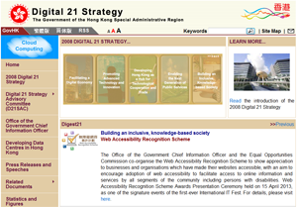
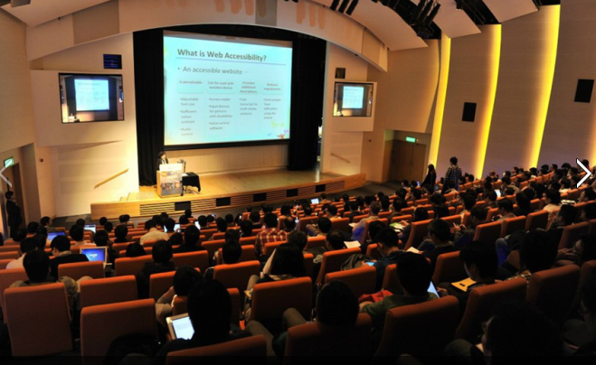
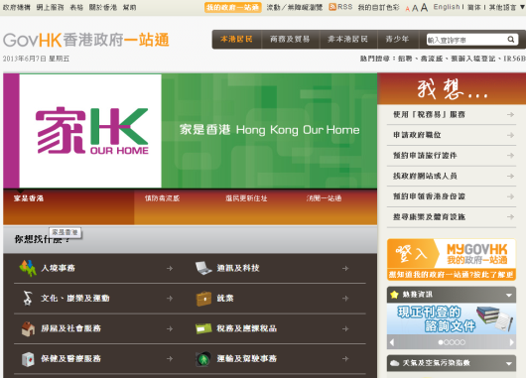
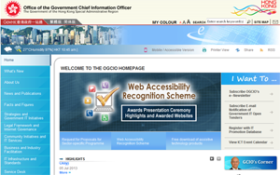
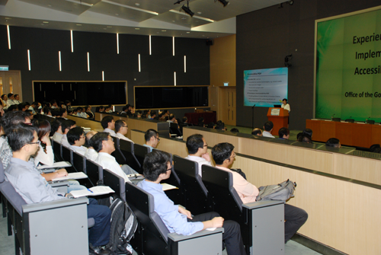
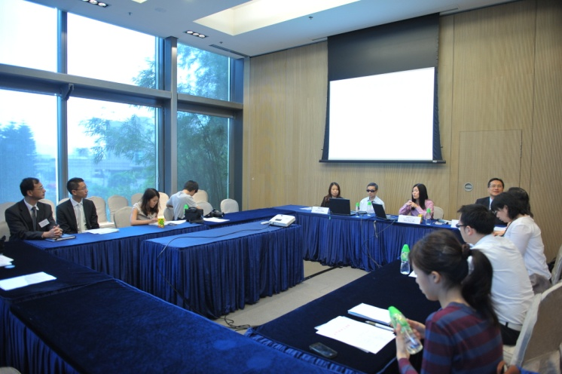
Web Accessibility Campaign
Government Leadership
Fostering Awareness
Government Leaders
Fostering Awareness
Government Websites
Seminars & Workshops
Public-sector organisations
Over 3000 participants

Slide 40
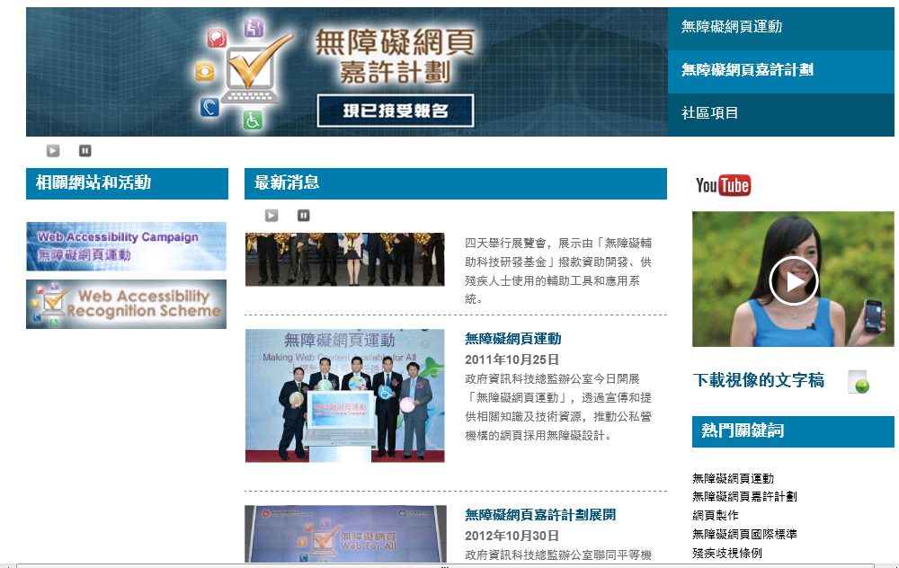
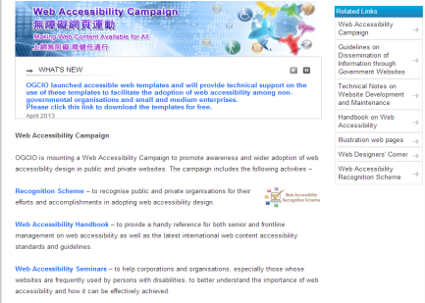
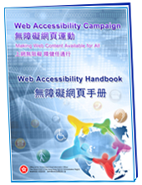
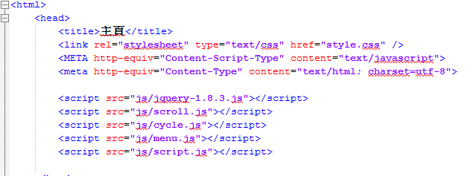
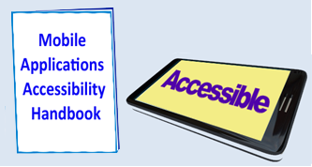
Web Accessibility Campaign
Promulgating Resources
Promulgating Resources
Accessible Webpage Templates
Webforall Portal
www.webforall.gov.hk
Mobile Applications
Accessibility Handbook

Slide 41
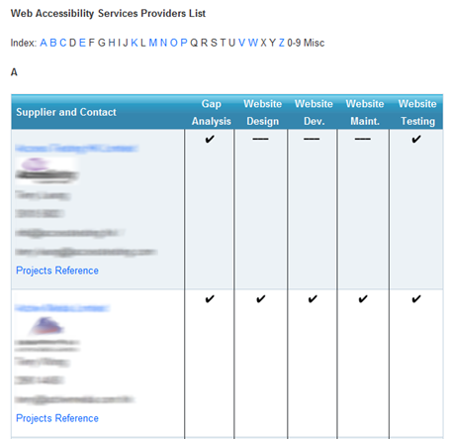
Webforall Portal
Web Designers’ Corner
facilitating the sourcing of ICT professional services for the implementation of web accessibility designs
www.webforall.gov.hk/web_designers_corner

Slide 42
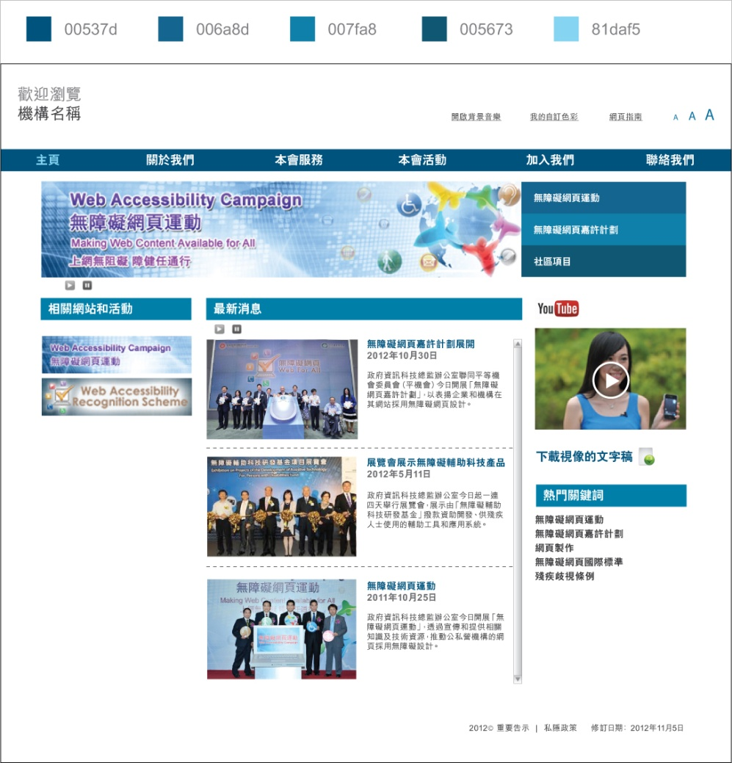
Accessible Webpage Templates
www.webforall.gov.hk/web_template
Sample codes incorporated with essential web accessibility features, e.g.
4. Provide User-initiated background audio
1. Provide “Skip To Content”
5. Allow text resize
6. Provide keyboard accessible menu
2. Provide meaningful alt text for images
7. Provide embedded video channel
3. Allow to play or pause the auto-scrolling latest news
8. Provide sufficient colour contrast

Slide 43
Web Accessibility Campaign
Building Expertise
Building Expertise
Incorporate Web Accessibility into ICT curricula

Slide 44
Web Accessibility Campaign
Encouraging Adoption
Encouraging Adoption
Web Accessibility Recognition Scheme
Reference to International standard
Verified by persons with disabilities
Free assessment and advisory services
Webforall accreditation logos

Slide 45
Agenda
What is and Why Web Accessibility?
International Standards & Broad Principles
Web Accessibility Campaign
Web Accessibility Recognition Scheme

Slide 46
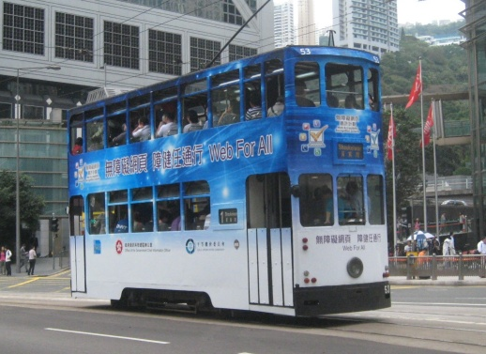
Web Accessibility Recognition Scheme
1st Recognition Scheme
香港聾人福利促進會
The Hong Kong Society for the Deaf
44 Gold Awards and 26 Silver Awards

Slide 47
Web Accessibility Recognition Scheme
Recognition Scheme 2013/14
Co-organise with Equal Opportunities Commission
Website / Mobile Apps^{NEW!} streams
Websites
g
Application Period: Sep to Dec 2013
Awards Presentation Ceremony in April 2014
APPS
Details to be announced in webforall portal -
www.webforall.gov.hk/recognition_scheme

Slide 48
Your Support to Web Accessibility
Adopt web accessibility for websites/mobile apps
Ensure colleagues and content providers are aware of the importance and having relevant skills
Encourage clients/business partners to do the same
Webforall

Slide 49
Your Support to Web Accessibility
Download and use Accessible Webpage Templates
Enrol Web Accessibility Recognition Scheme 2014
Fill out and return the Survey on Content Management System
Check out Social Welfare Development Fund latest news
Webforall

Slide 50
Enquiry
Web Accessibility Programme Office
Email address : wac@ogcio.gov.hk
Telephone no. : 2582 6079
Website : www.webforall.gov.hk

Slide 51
Let’s join hands in making a digitally inclusive society
Thank you!

