Slide 1
Web Accessibility Recognition Scheme 2016
How to Meet the Accreditation Criteria (Mobile App Stream)
Office of the Government Chief Information Officer
Digital Inclusion Division
30 October 2015

Slide 2
Scope of Assessment – Mobile App Stream
Main screen
One-time Setup Wizard or Welcome / Settings / About Us screen(s)
All first-level screens
Three core business
functions nominated
by entrants
Screen 00
Restaurant
Main Screen
Screen 11
Online Food Menu
Screen 12
Category Selection
Screen 13
Food listing
Screen 21
Members’ Corner
Screen 22
Join us Registration
Screen 23
Confirmation
Screen 31
Latest Promotion
Screen 32
Promotion Dishes Details
Screen 41
Shop Location
Screen 42
Shop List
Screen 43
Shop Address
Screen 51
Settings
Screen 01
On-time Setup
Wizard/Welcome Screen
Scheme 61
About Us
Mock-up mobile app hierarchy

Slide 3
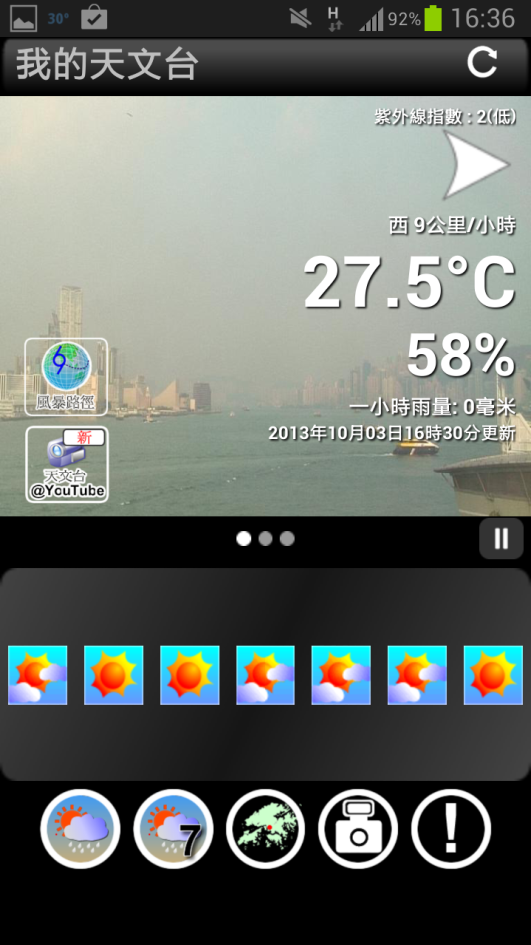
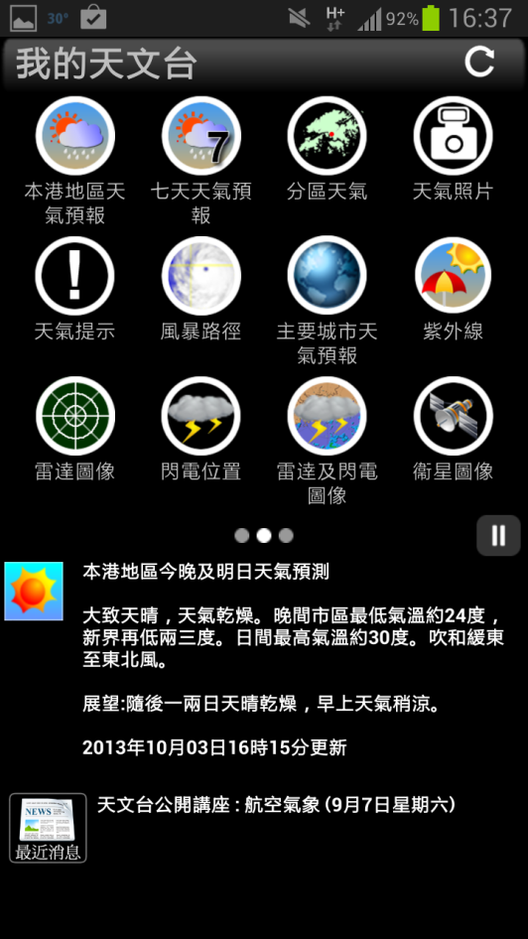
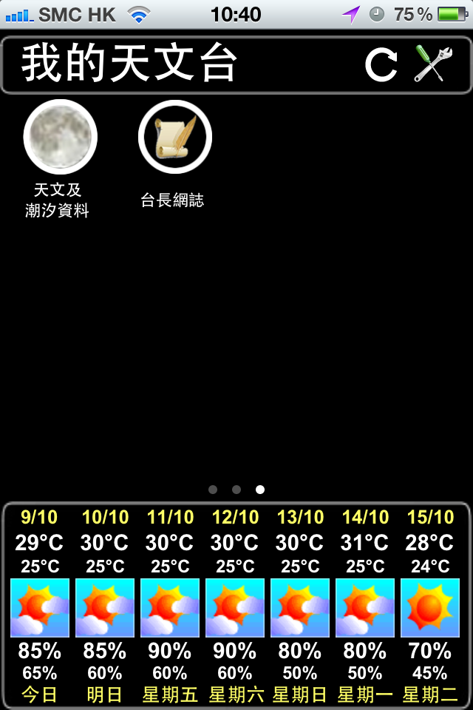
Scope of Assessment – Mobile Stream
Main screen – My Observatory

Slide 4
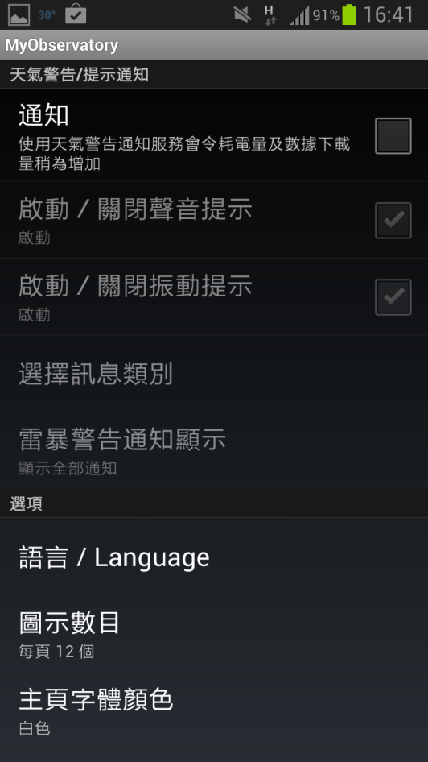
Scope of Assessment – Mobile Stream
Main screen – My Observatory
4. Core business 1
5. Core business 2
2. Settings
3. All first-level screens
6. Core business 3

Slide 5
Judging Criteria
Mobile Application Stream (Silver)
No. | Criteria
M01 | Provide meaningful text alternative for non-text contents
M02 | Easy to turn off background sound or set as user-initiated only
M03 | Make all clickable objects large enough to be tapped
M04 | Provide clear and simple headings
M05 | Provide consistent and simple user interface structure
M06 | Provide meaningful content sequence
M07 | Provide navigation for going backward
M08 | Provide clear and informative links
M09 | Text resize function or text can be zoomed without loss of content
M10 | Compatible with screen readers
M11 | Provide contact points or “email feedback” as well as an accessibility statement
Silver : 11 Judging Criteria

Slide 6
Judging Criteria
Mobile Application Stream (Gold)
No. | Criteria
M12 | Provide sufficient colour contrast
M13 | Provide sufficient time for users to read the content and operate the function
M14 | Provide transcript, captions or sign language for 30% of pre-recorded videos published in the recent 2 years
M15 | Provide alternative means for notification
M16 | Provide input assistance such as proper labels or instructions for user input
M17 | Provide error prevention for transactions
M18 | Provide means to close popovers
Gold : 7 Judging Criteria

Slide 7
Testing Steps
Visual Review (目視檢查)
Color Contrast Review (色差對比檢查)
Manual Testing with Screen Reader (使用讀屏軟件進行手動檢測)
Human Testing (使用者測試)

Slide 8
Screen Readers
To identify and interpret what is being displayed on the screen
iOS: VoiceOver
Proprietary by Apple
Support multiple languages without need to install Text-to-Speech Engine
Android: TalkBack
Open source
Require to install third-party Text-to-Speech Engine
(e.g. Ekho (余音) - Free Text-to-Speech engine for Cantonese)

Slide 9
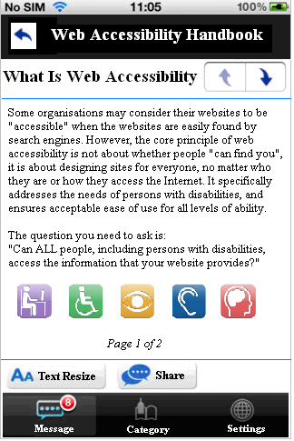
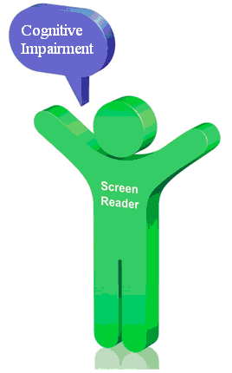
M01 (Silver Award)
1. Meaningful Text Alternative
No alternatives for non-text content
Persons with visual impairment cannot perceive the image content

Slide 10
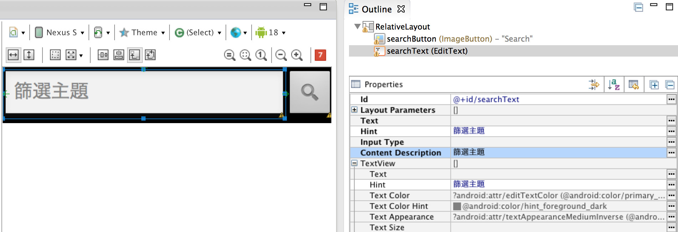
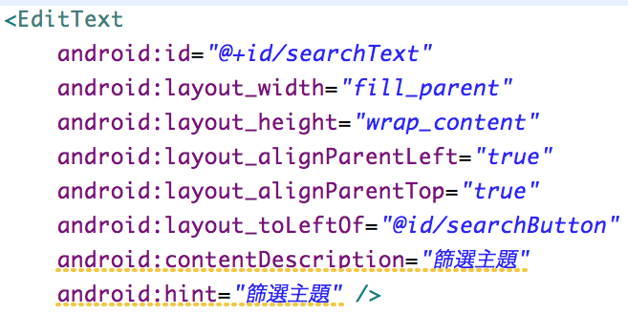
M01 (Silver Award)
1. Meaningful Text Alternative
Android :
Check Content Description in layout xml

Slide 11
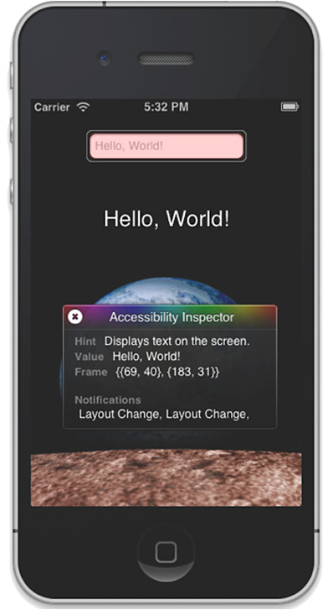
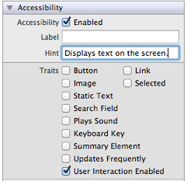
M01 (Silver Award)
1. Meaningful Text Alternative
iOS:
Enable Accessibility features (XCode)
VoiceOver users rely on the labels and hints to use the application

Slide 12
M01 (Silver Award)
1. Alternate Text
Provide meaningful alternative text for non-text elements such as image, button, etc
Provide null alternative text for decorative image
Screen reader should read menu item / function block with "button" or "按鈕“
Alternative text should be consistency with user's language i.e. alternative text should not be in English for Chinese interface
Pay attention to date format. e.g. 2014年2月14日 is more meaningful than 2014/2/14
Voice Captcha available when turn on screen reader

Slide 13
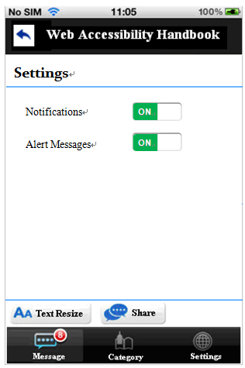
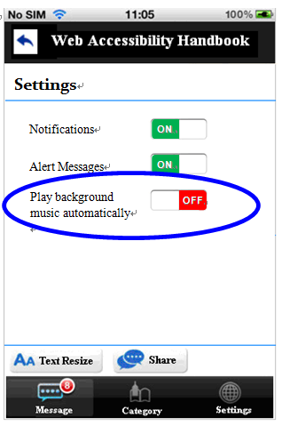
M02 (Silver Award)
2. Background Sound
Easy to turn off background sound or set as user-initiated only
✗
✓
Testing: Visual Review, Manual Testing with Screen Reader

Slide 14
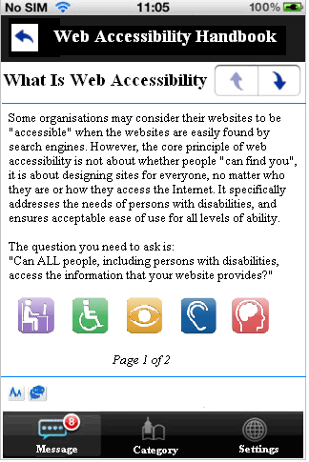
M03 (Silver Award)
3. Clickable Object Size
Make all clickable objects large enough for tapping
✗
✓

Slide 15
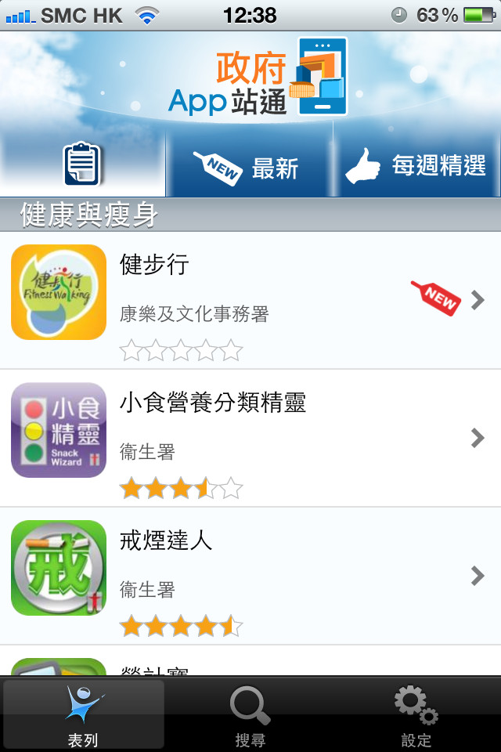
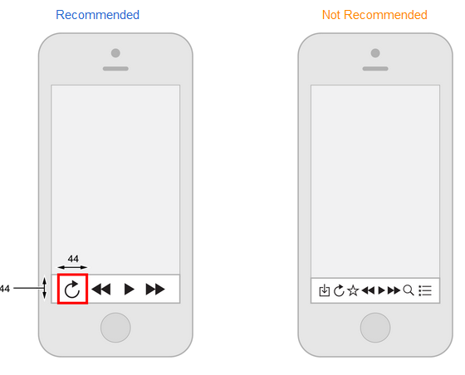
M03 (Silver Award)
3. Clickable Object Size
Testing: Visual Review
Button and Links are large enough for tapping
Android: > 9mm
iOS: 44 x 44 points
Source : http://www.gov.hk/en/about/govdirectory/mobilesites.htm

Slide 16
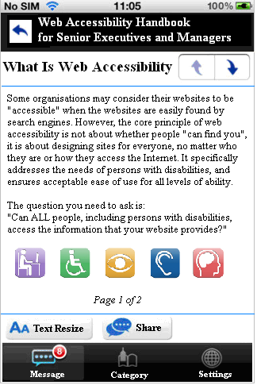
M04 (Silver Award)
4. Headings
Provide clear and simple headings
✗
✓

Slide 17
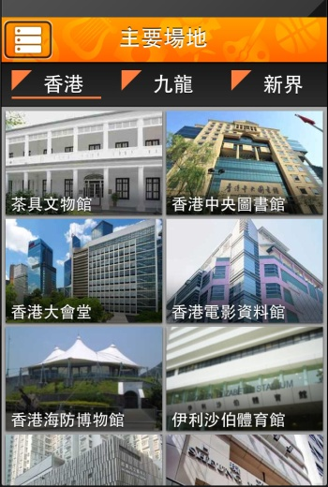
M04 (Silver Award)
4. Headings
Testing: Visual Review, Manual Test with Screen Reader
Clear and simple headings
Source : http://www.gov.hk/en/about/govdirectory/mobilesites.htm

Slide 18
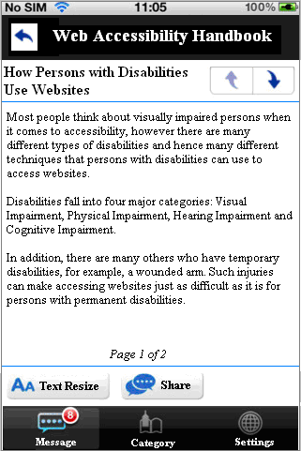
M05 (Silver Award)
5. Structure and Content
Provide consistent and simple user interface structure
✗
✓

Slide 19
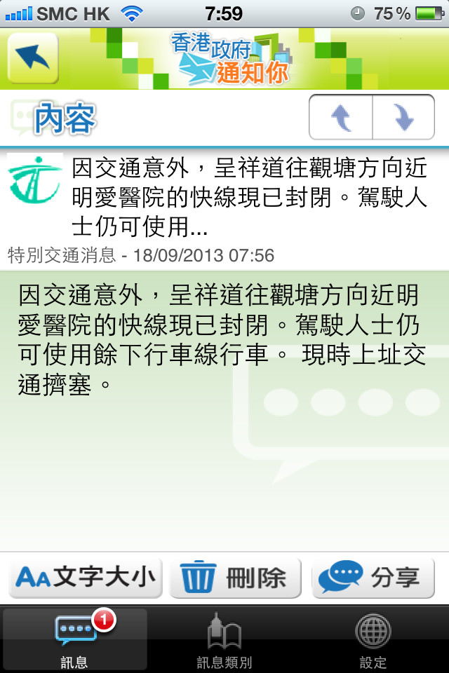
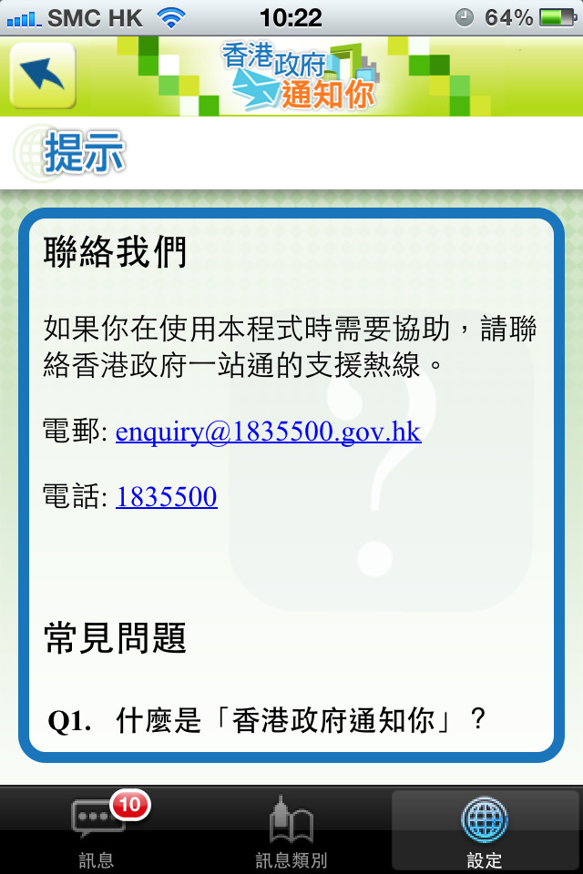
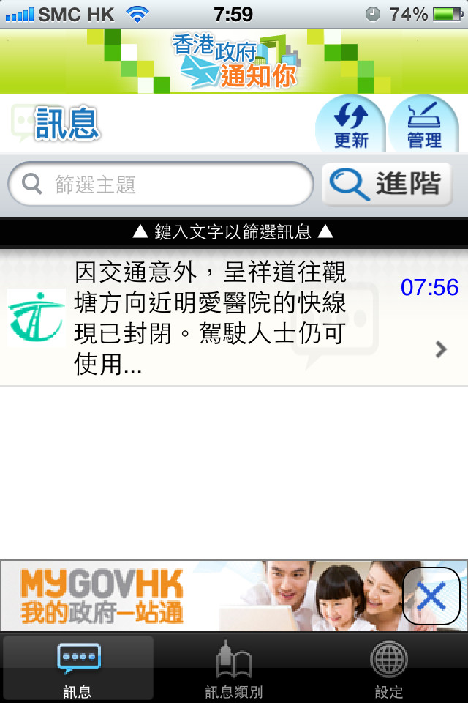
M05 (Silver Award)
5. Structure and Content
Testing: Visual Review, Manual Test with Screen Reader
Source : http://www.gov.hk/en/about/govdirectory/mobilesites.htm

Slide 20
M06 (Silver Award)
6. Meaningful Sequence
Make sure the content is coded in a logical order
✗
H2
✓

Slide 21
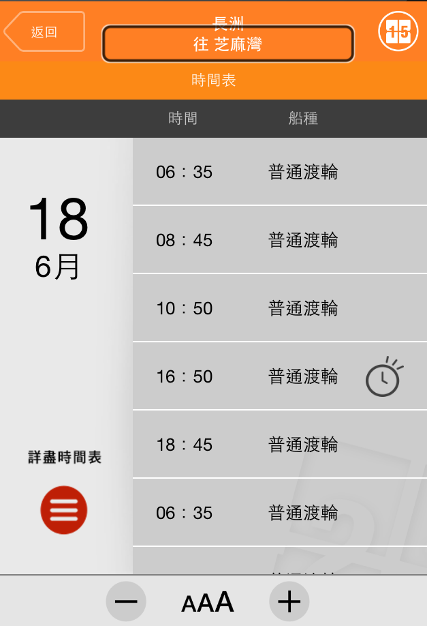
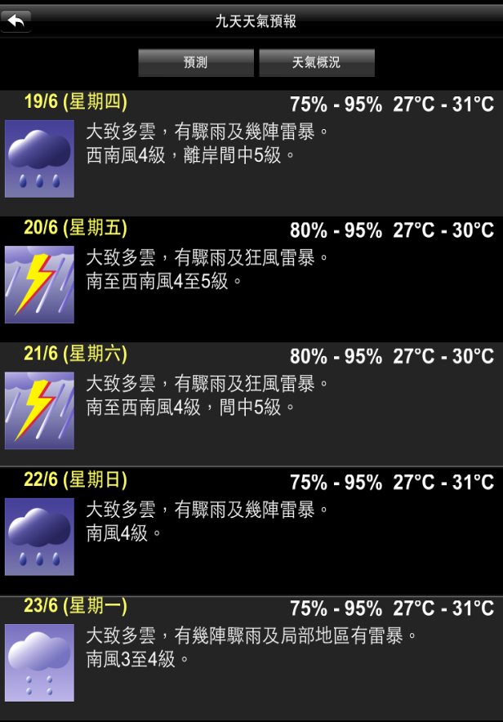
M06 (Silver Award)
6. Meaningful Sequence
Testing: Manual Testing with Screen Reader
More examples:
H2
Source : First Ferry Mobile App
Source : GovHK Apps
Source : MyObservatory Mobile App

Slide 22
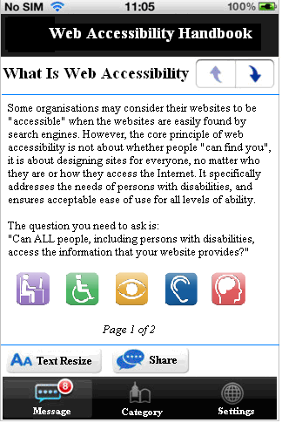
M07 (Silver Award)
7. Navigation
Provide navigation for going backward
✗
✓

Slide 23
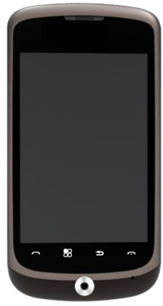
M07 (Silver Award)
7. Navigation
Testing: Visual Review, Manual Test with Screen Reader
Some Android devices have hardware key with backward button
Source : http://www.gov.hk/en/about/govdirectory/mobilesites.htm

Slide 24
M08 (Silver Award)
8. Links
Provide clear and informative links
✗
✓

Slide 25
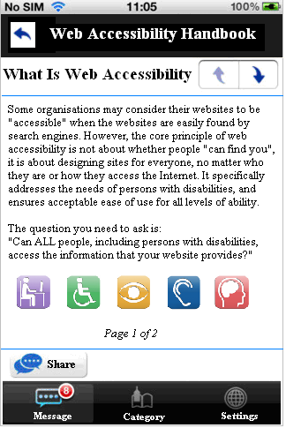
M09 (Silver Award)
9. Text Resize
Text resize function or text can be zoomed without loss of content
✗
✓

Slide 26
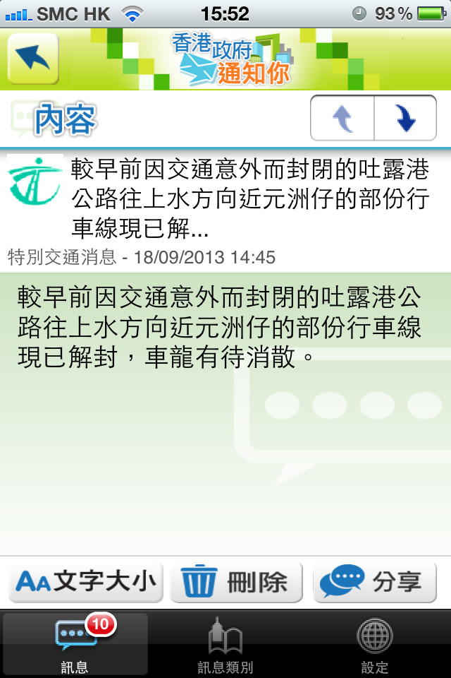
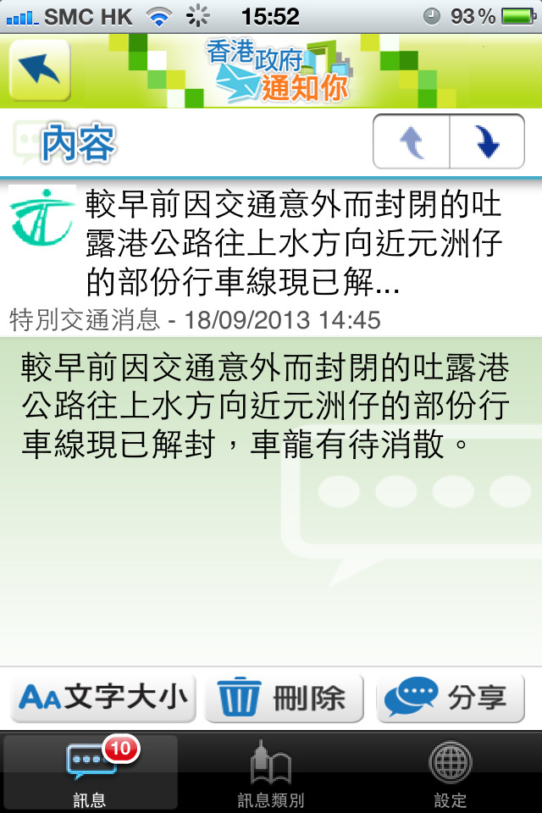
M09 (Silver Award)
9. Text Resize
Testing: Visual Review and Human Testing
Text resize without loss of content
Source : http://www.gov.hk/en/about/govdirectory/mobilesites.htm

Slide 27
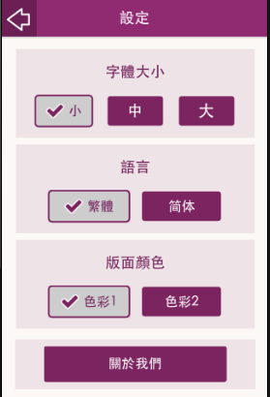
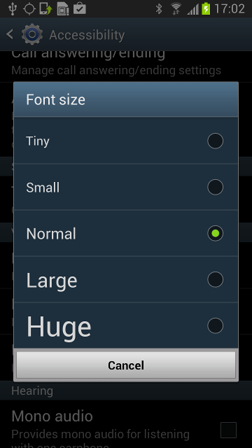
M09 (Silver Award)
9. Text Resize
In App’s Setting
In System Setting

Slide 28
M10 (Silver Award)
10. Not Compatible with Screen Reader
All contents, function, gesture should be in order when using with screen reader
App should not crash when using with screen reader
Maps engine ( such as Google Map or Apple Map) may not be easy to use with screen reader, other alternative means should be provided (e.g. a list of nearby car parks)
Alert message/declaration should be provided prior inaccessible items (e.g. Games )
H2

Slide 29
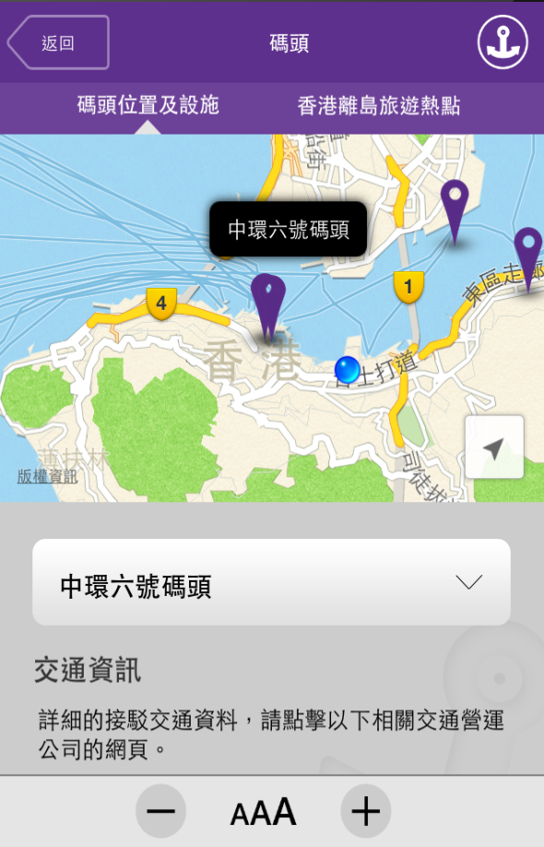
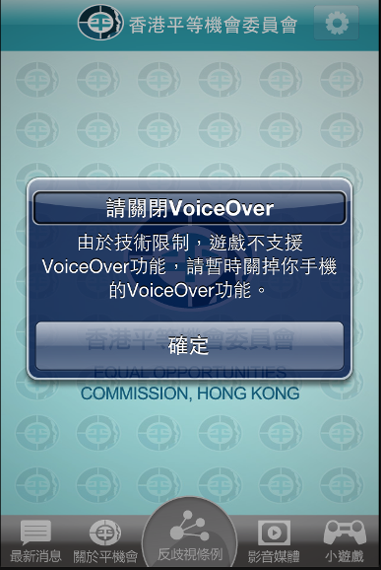
M10 (Silver Award)
10. Not Compatible with Screen Reader
Selection menu provided to access location information
Alert box was pop up prior to access Mini Game
H2
Source : First Ferry Mobile App
Source : Equal Opportunities Commission Mobile App

Slide 30
M11 (Silver Award)
11. Accessibility Statement
Provide contact points or email feedback as well as an accessibility statement
✗
✓

Slide 31
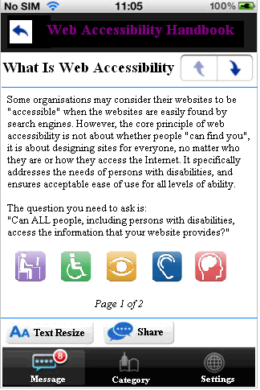
M12
(Gold Award)
12. Sufficient Colour Contrast
The visual presentation of text and image of text has a contrast ratio of at least 4.5 : 1. Logo or brand name is exempted
2 : 1
15 :1
✗
✓

Slide 32
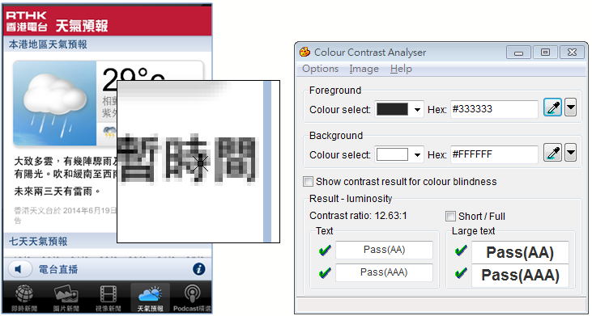
M12
(Gold Award)
12. Sufficient Colour Contrast
Testing: Colour Contrast Anaylser
https://www.paciellogroup.com/resources/contrastanalyser/

Slide 33
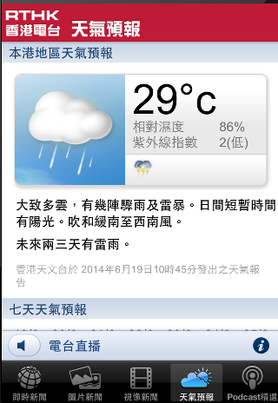
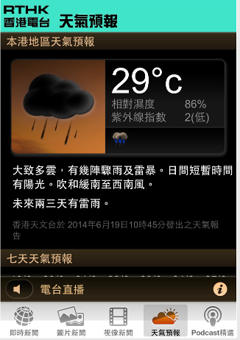
M12
(Gold Award)
12. Sufficient Colour Contrast
Invert Color : Built-in application to convert text in white-on-black or negative colors, helps improve contrast
Source : http://www.gov.hk/en/about/govdirectory/mobilesites.htm

Slide 34
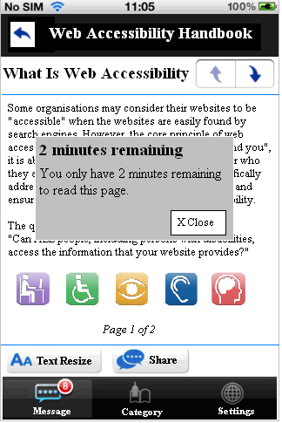
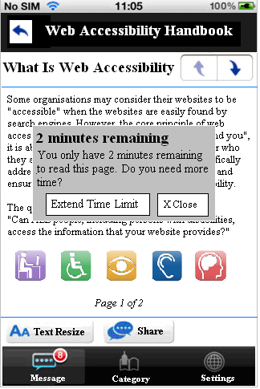
M13
(Gold Award)
13. Time-limited Function
Provide sufficient time for user to read the content or operate the function
✗
✓

Slide 35
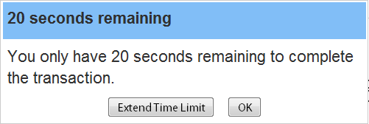
M13
(Gold Award)
13. Time-limited Function
Testing: Visual Review, Manual Testing with Screen Reader

Slide 36
M14
(Gold Award)
14. Video
Provide transcript, captions or sign language for 30% of pre-recorded videos published in the recent 2 years
✗
✓

Slide 37
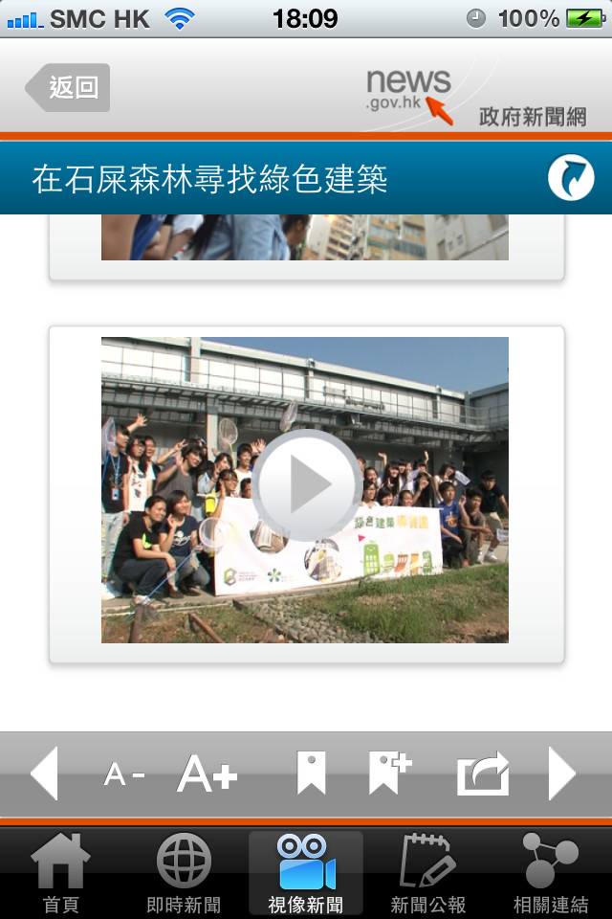
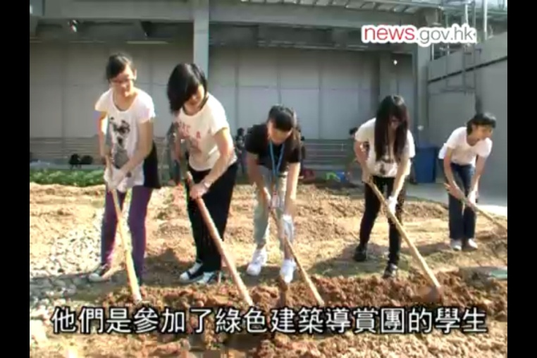
M14
(Gold Award)
14. Video
Testing: Visual Review
Source : http://www.gov.hk/en/about/govdirectory/mobilesites.htm

Slide 38
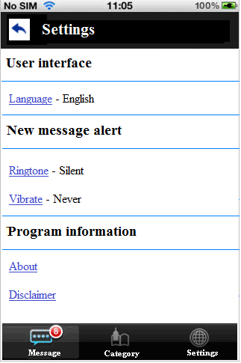
M15
(Gold Award)
15. Notification
Provide alternative means for notification
✗
✓

Slide 39
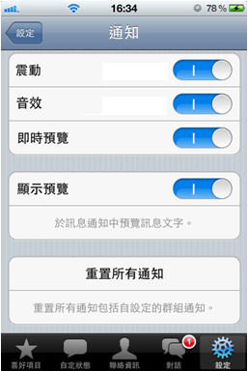
M15
(Gold Award)
15. Notification
Testing: Visual Review, Manual Testing with Screen Reader

Slide 40
M16
(Gold Award)
16. Input Assistance
Provide input assistance such as proper labels or instructions for user input
✗
✓

Slide 41
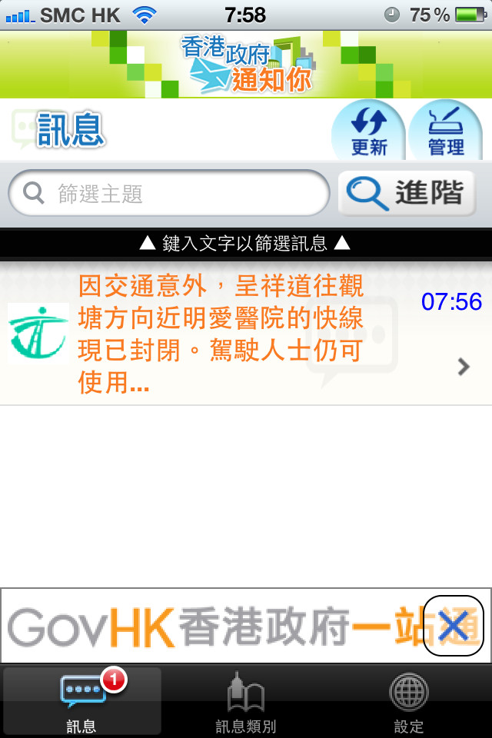
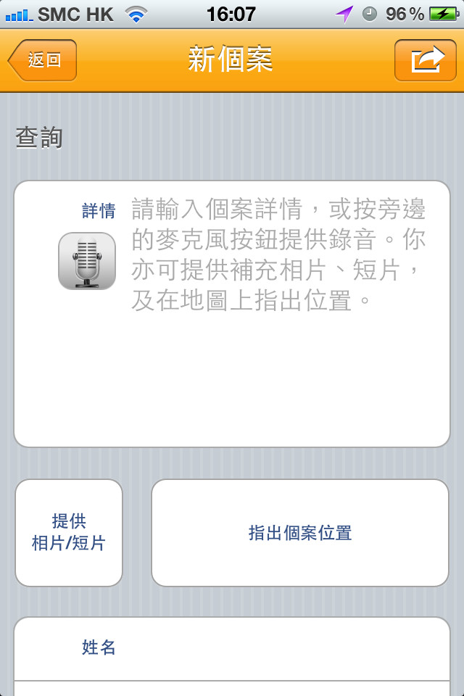
M16
(Gold Award)
16. Input Assistance
Testing: Visual Review, Manual Testing with Screen Reader
Source : http://www.gov.hk/en/about/govdirectory/mobilesites.htm

Slide 42
M17
(Gold Award)
17. Error Prevention
Provide error prevention (allow reversible) for transactions for legal or financial transactions
✗
✓

Slide 43
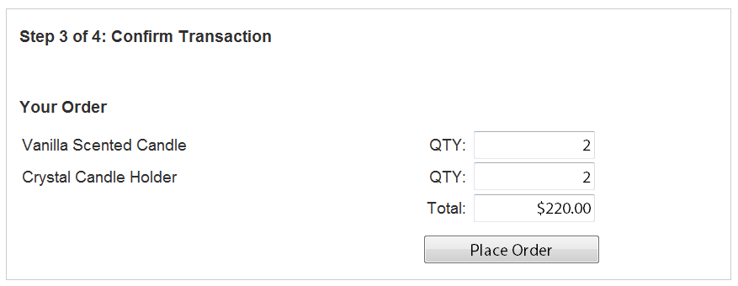
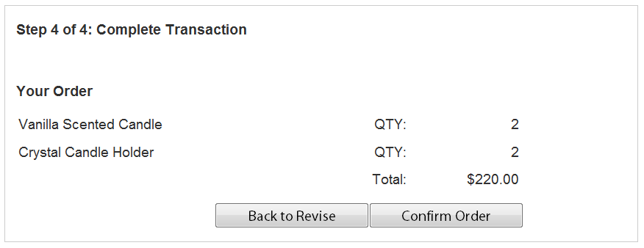
M17
(Gold Award)
17. Error Prevention
Testing: Manual Testing with Screen Reader

Slide 44
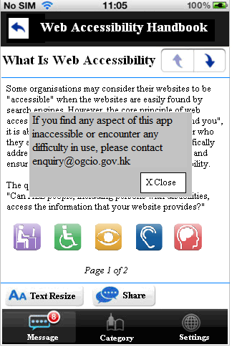
M18
(Gold Award)
18. Popover
Provide means to close a popover screen.
✗
✓

Slide 45
Thank you!

