Slide 1
Ms Joanna Chan, Assistant Systems Manager
Office of the Government Chief Information Officer
Digital Inclusion Division
27 June 2014
Web Accessibility Recognition Scheme

Slide 2
Web Accessibility Recognition Scheme
Agenda
Introduction to the Scheme
Mobile Application Stream
Mobile App Accessibility Handbook

Slide 3
Web Accessibility Recognition Scheme
Objectives
Recognise efforts and achievements in adoption of web accessibility design
Raise awareness in the community and encourage wider adoption

Slide 4
Web Accessibility Recognition Scheme
Structure
Co-organise with the Equal Opportunities Commission (EOC)
Led by an Advisory Committee comprising members from
Government and EOC
Non-profit making organisations －
Visual Impairment
Physical Impairment
Hearing Impairment
Members from ICT Industry
www.webforall.gov.hk/scheme

Slide 5
Web Accessibility Recognition Scheme
Framework
Website / Mobile Apps Streams
Gold / Silver Awards
My Favourite Website Awards
Annual Event
Open to all local enterprises and non-governmental organisations

Slide 6
Benefits of Joining the Scheme
Social Responsibility
Making websites/mobile applications accessible
Contributing to a caring and inclusive society
Recognition and Achievements
Receiving an award and building positive corporate image
Cost Savings
Familiarising of good practices and saving maintenance cost
Enhancing Competitiveness
Making websites more friendly to search engines
Widening reach-out
Corporate
Social
Responsibility

Slide 7
Benefits of Joining the Scheme
Publicity
Entitle to use award logos for promotional purposes
Invite to share experiences at public events/seminars
Publish achievements on
Interview by online media
Recognition Scheme websites, online banners
Local free / paid newspapers, magazines
Newspaper advertorials
Booklet insertion via newspaper
Radio interviews

Slide 8
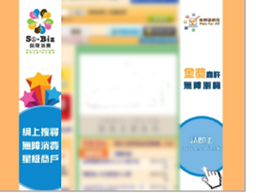
Web Accessibility Recognition Scheme
Award Logos Used for Promotional Purposes

Slide 9
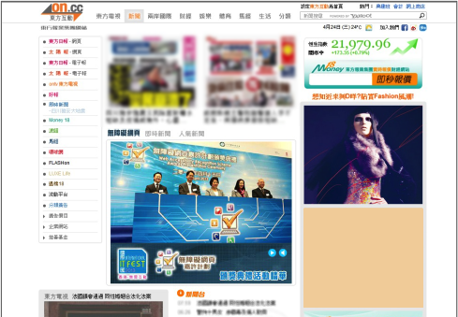
Web Accessibility Recognition Scheme
Awards Presentation Ceremony Highlights in Newspaper Website

Slide 10
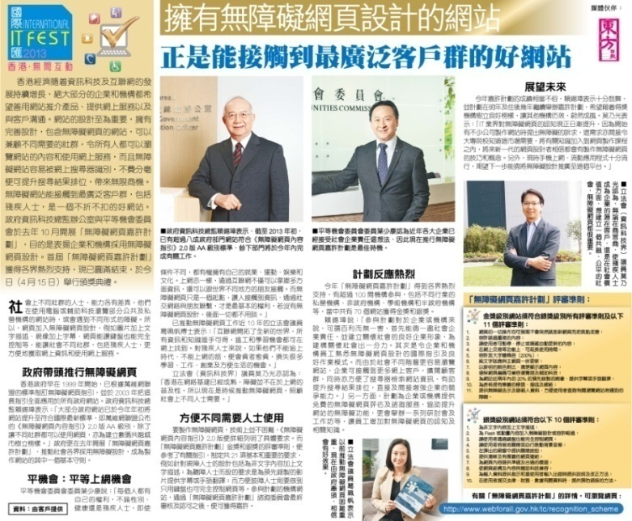
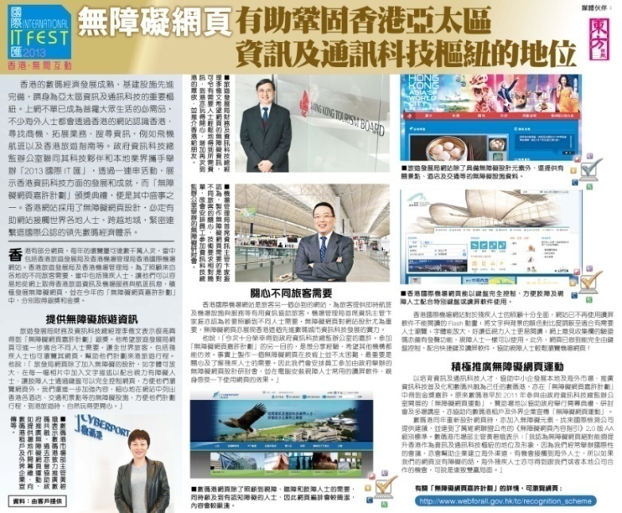
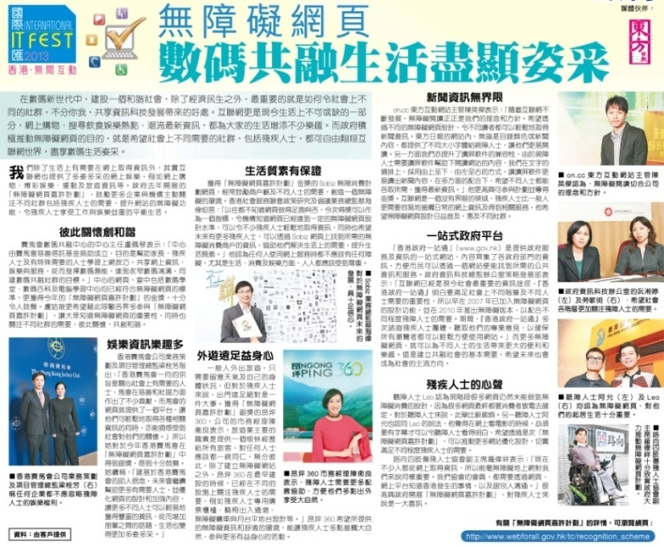
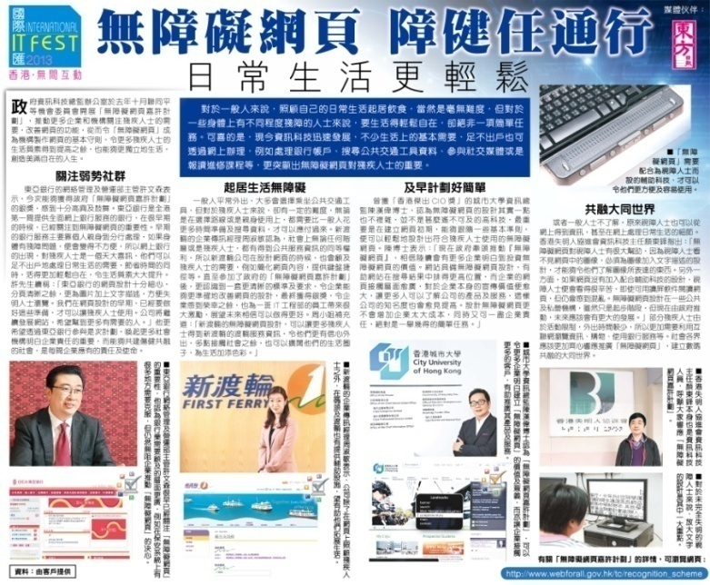
Web Accessibility Recognition Scheme
Advertorials and Booklet Insertion
via Newspaper

Slide 11
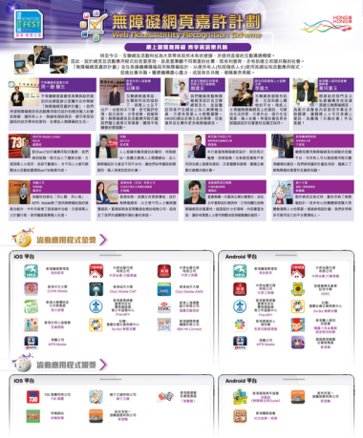
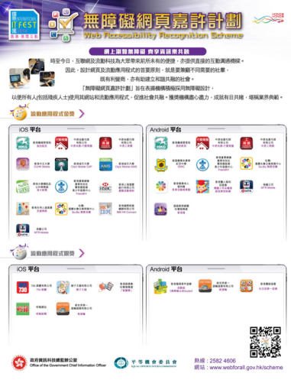
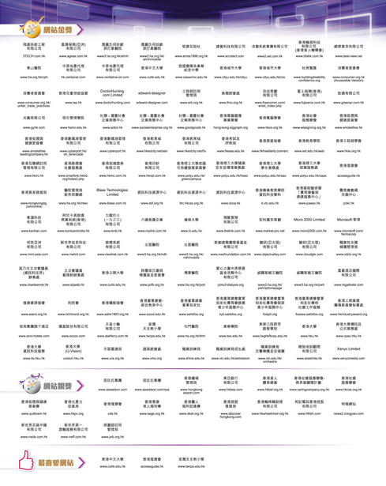
Web Accessibility Recognition Scheme
Awardees List and Advertorials in Newspapers and Magazine

Slide 12
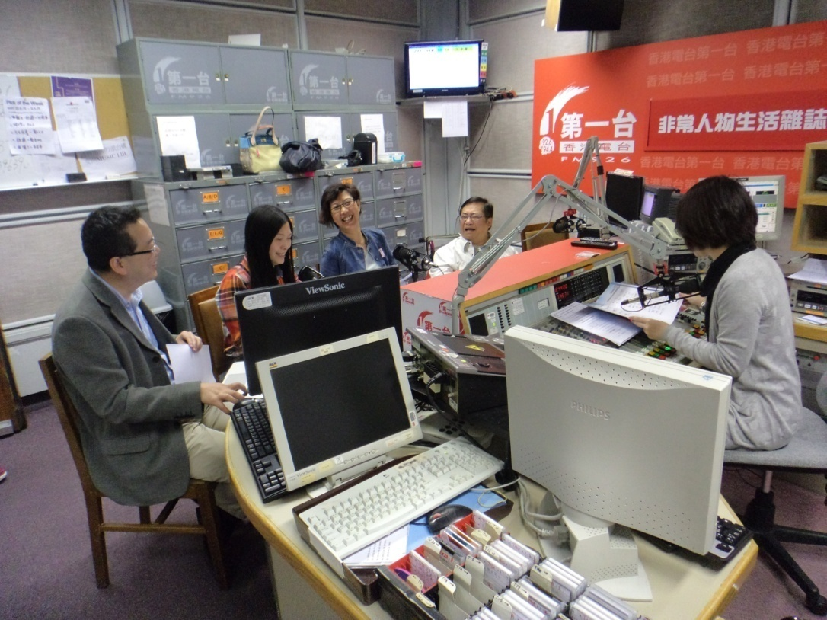
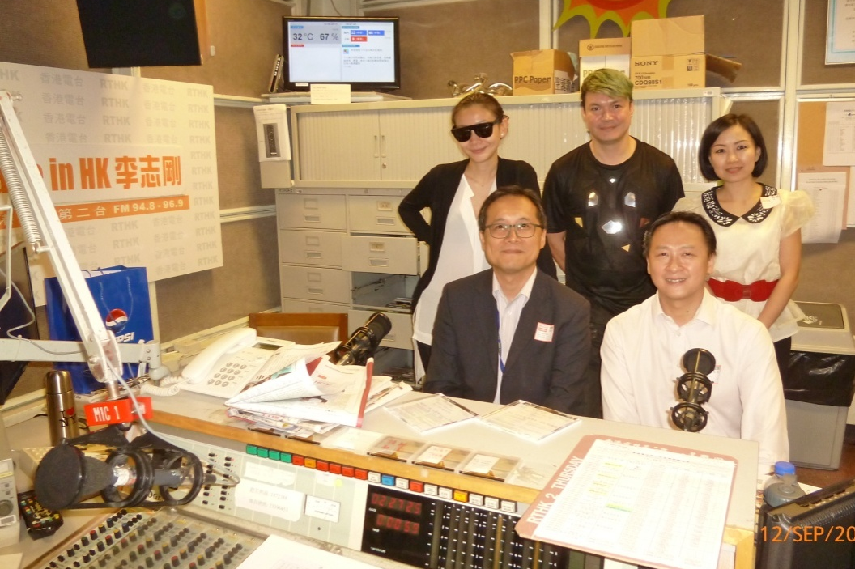
Web Accessibility Recognition Scheme
Radio Interviews

Slide 13
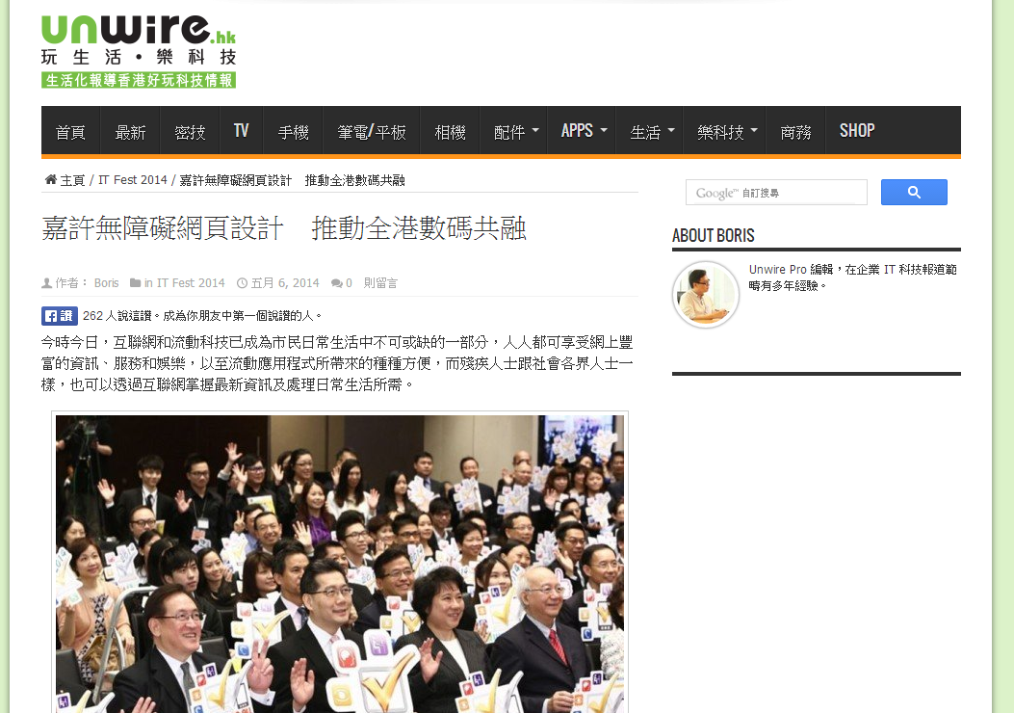
Web Accessibility Recognition Scheme
Awards Presentation Ceremony Highlight in Unwire Website

Slide 14
Web Accessibility Recognition Scheme 2014
Awards Presentation Ceremony
110
Organisations
136 Websites
31 Mobile Apps
3 Most Favourite Websites
117 Gold and 19 Silver
23 Gold and 8 Silver
Awards Presentation Ceremony of Web Accessibility Recognition Scheme 2014

Slide 15
Web Accessibility Recognition Scheme 2015
Tentative Schedule
Stage | Key Tasks | Period
1. | Open for Application | Aug – Sep 2014
2. | Initial Assessment and Enhancement | Sep – Dec 2014
3. | Awards Presentation Ceremony | April 2015

Slide 16
Web Accessibility Recognition Scheme
Agenda
Introduction to the Scheme
Mobile Application Stream
Mobile App Accessibility Handbook

Slide 17
Web Accessibility Recognition Scheme 2014
Mobile Application Stream
Award | No. of Judging Criteria | Accreditation Logo
Silver | 10
Gold | 8

Slide 18
Web Accessibility Recognition Scheme 2014
Judging Criteria – Mobile Application Stream (Silver)
No. | Criteria
1 | Provide meaningful text alternative for non-text contents
2 | Easy to turn off background sound or set as user-initiated only
3 | Make all clickable objects large enough to be tapped
4 | Provide clear and simple headings
5 | Provide consistent and simple user interface structure
6 | Provide meaningful content sequence
7 | Provide navigation for going backward
8 | Provide clear and informative links
9 | Text resize function or text can be zoomed without loss of content
10 | Compatible with screen readers

Slide 19
Web Accessibility Recognition Scheme 2014
Judging Criteria – Mobile Application Stream (Gold)
No. | Criteria
1 | Provide sufficient colour contrast
2 | Provide sufficient time for users to read the content and operate the function
3 | Provide captions or sign language for 30% of pre-recorded videos published in the recent 2 years
4 | Provide alternative means for notification
5 | Provide input assistance such as proper labels or instructions for user input
6 | Provide error prevention for transactions
7 | Provide means to close popovers
8 | Provide contact points or “email feedback” feature

Slide 20
Web Accessibility Recognition Scheme
Agenda
Introduction to the Scheme
Mobile Application Stream
Mobile App Accessibility Handbook

Slide 21
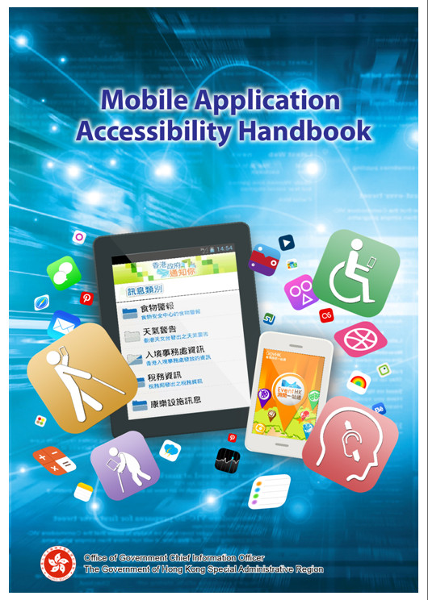
Mobile Application Accessibility Handbook
www.webforall.gov.hk/en/maahandbook
Designed for mobile application owners and developers
Based on the WCAG 2.0 and feedbacks collected from local disability groups
Basic Concept
Best Practices
Checklist for Developers
Testing Strategy
Useful Reference
APPS
www.webforall.gov.hk

Slide 22
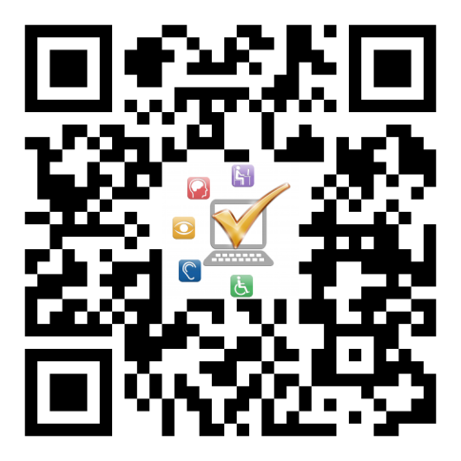
Thank you!
Web Accessibility Campaign Programme Office
Email : wac@ogcio.gov.hk
Tel. no. : 2582 4606
Web Accessibility Campaign
www.webforall.gov.hk
Web Accessibility Recognition Scheme
www.webforall.gov.hk/scheme

