Slide 1
Introduction to Web Accessibility
and Recognition Scheme 2015
Office of the Government Chief Information Officer
Digital Inclusion Division
5 December 2014

Slide 2
Programme Rundown
Time (pm) | Program
2:15 – 2:30 | Introduction to Web Accessibility and Recognition Scheme 2015 Elke Mak OGCIO
2:30–3:15 | Web Accessibility Implementation Ivy Sit OGCIO
3:15–3:30 | Demonstration on How a Visually Impaired Person Using a Website Johnny Ngan and Daniel Cheng Hong Kong Blind Union
3:30–4:00 | Video Sharing
4:00–4:15 | Q&A

Slide 3
Agenda
Digital 21 Strategy
What is Web Accessibility?
Web Accessibility Campaign
Web Accessibility Recognition Scheme

Slide 4
HK ICT Infrastructure
Broadband Penetration
Household broadband
penetration rate: 83%
Among the highest
Internet Connection Speed
Fastest in the world
Mobile Phone
12.7 million users (July 2014)
Mobile penetration rate: 240%
(among the highest in the world)
Wi-fi
Free Wi-fi at government facilities
> 28 000 Wi-fi access points
Telecommunications charges are among the lowest worldwide

Slide 5
Digital 21 Strategy
One of the key areas of Digital 21 Strategy
ICT as a Tool to Support Underprivileged Groups
Expand their social horizons
Integrate with the society
Enhance their quality of life
Digital Inclusion

Slide 7
Digital Inclusion – Priority Groups
Students from low income families
have Internet access at home and do not lose educational opportunity because of financial difficulties or lack of support
Elderly
encourage more elderly to use ICT in their daily life for social and generational inclusion
Persons with disabilities
minimise the barriers on the use of ICT
drive wider adoption of ICT to improve their quality of life

Slide 8
What is Web Accessibility?
Making web Content available for ALL
ALL people of the community
Including persons with disabilities (361,000 about 5.2% of total population)
Video on Introduction of Web Accessibility
http://www.ogcio.gov.hk/tc/community/web_accessibility/recognition_scheme/2014/video/wars_video1.mp4

Slide 9
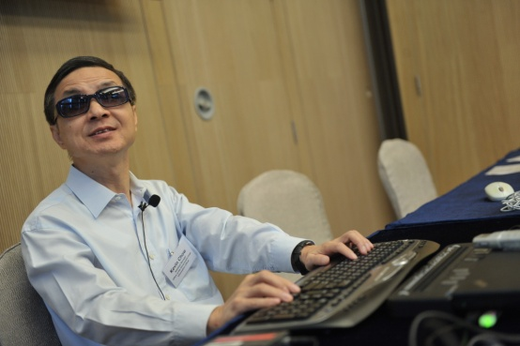
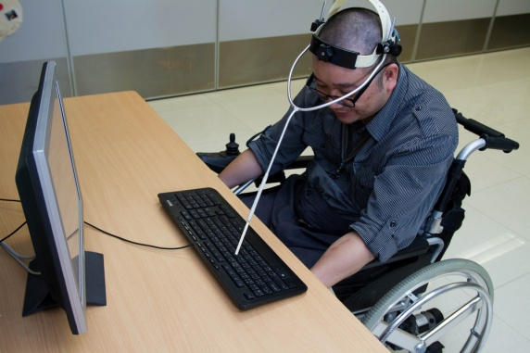
Four Major Categories of Disabilities
Visual Impairment
blind, low vision, colour blindness
Physical Impairment
missing limbs, reduced control of limbs, suffer from dexterity problems, epilepsy
Hearing Impairment
completely or partially deaf
Cognitive Impairment
have difficulties in learning

Slide 10
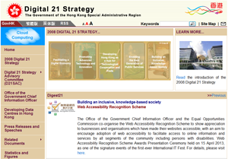
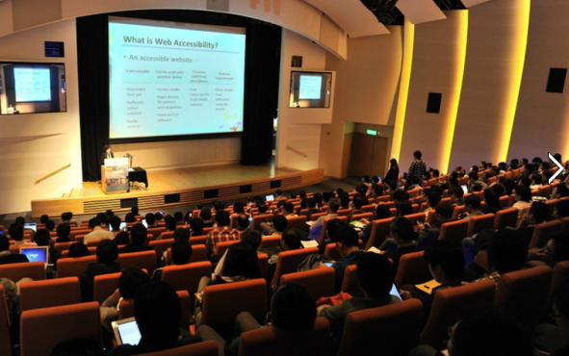
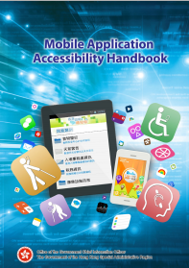
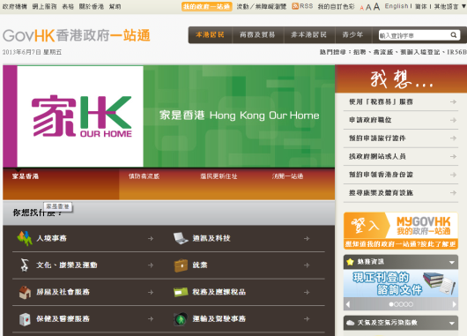
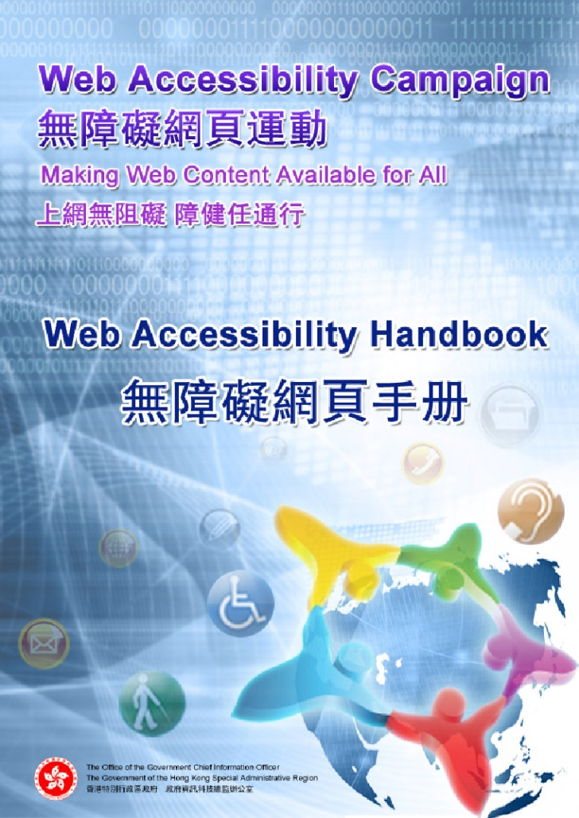
Web Accessibility Campaign since 2011
To promote adoption of web accessibility in public and private organisations
Multi-pronged approach
Government Leadership
Fostering Awareness
Promulgating Resources
webforall.gov.hk
Building Expertise
Encouraging Adoption

Slide 11
Web Accessibility Recognition Scheme
Objectives
Since 2013, recognise efforts and achievements in adoption of web accessibility design
Raise awareness in the community and encourage wider adoption

Slide 12
Web Accessibility Recognition Scheme
Structure
Co-organise with the Equal Opportunities Commission (EOC)
Led by an Advisory Committee comprising members from
Government and EOC
Non-profit making organisations －
Visual Impairment
Physical Impairment
Hearing Impairment
Members from ICT Industry
www.webforall.gov.hk/scheme

Slide 13
Web Accessibility Recognition Scheme
Framework
Website / Mobile Apps Streams
Gold / Silver Awards
Most Favourite Website / Mobile App Awards
Triple Gold Award ^{NEW}
Designer Award for Website / App Developers ^{NEW}
Annual Event
Open to all local enterprises & non-governmental organisations

Slide 14
Benefits of Joining the Scheme
Social Responsibility
Making websites/mobile apps accessible
Contributing to a caring and inclusive society
Recognition and Achievements
Receiving an award and building positive corporate image
Cost Savings
Familiarising of good practices and saving maintenance cost
Enhancing Competitiveness
Making websites more friendly to search engines
Widening reach-out
Corporate
Social
Responsibility

Slide 15
Benefits of Joining the Scheme
Publicity
Entitle to use award logos for promotional purposes
Invite to share experiences at public events/seminars
Publish achievements on
Interview by online media
Recognition Scheme websites, online banners
Local free / paid newspapers, magazines
Newspaper advertorials
Booklet insertion via newspaper
Radio interviews
Youtube

Slide 16
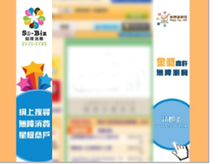
Web Accessibility Recognition Scheme
Award Logos Used for Promotional Purposes

Slide 17
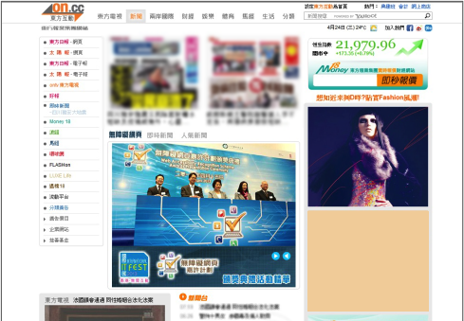
Web Accessibility Recognition Scheme
Awards Presentation Ceremony Highlights in Newspaper Website

Slide 18
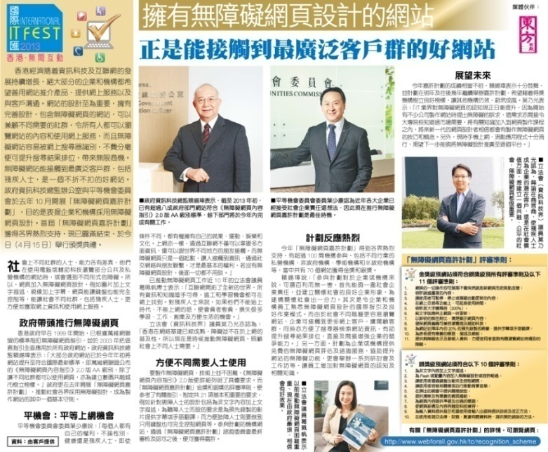
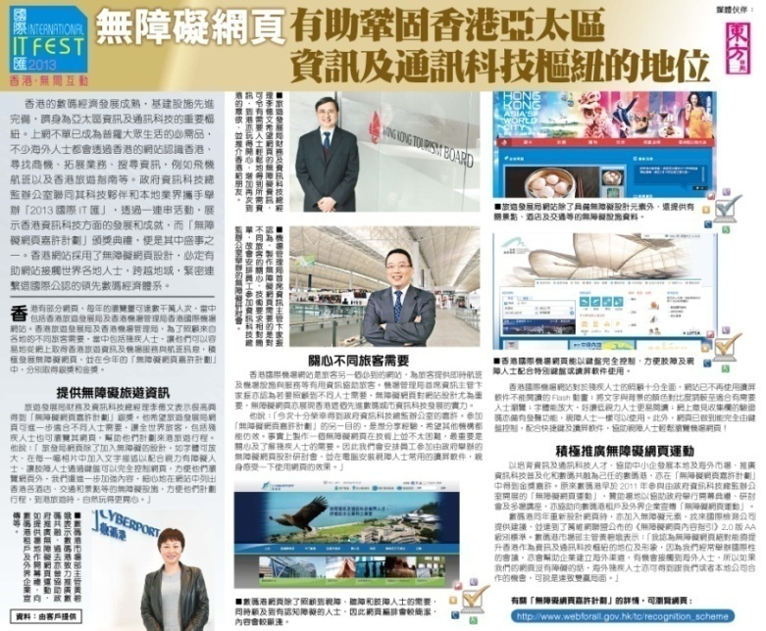
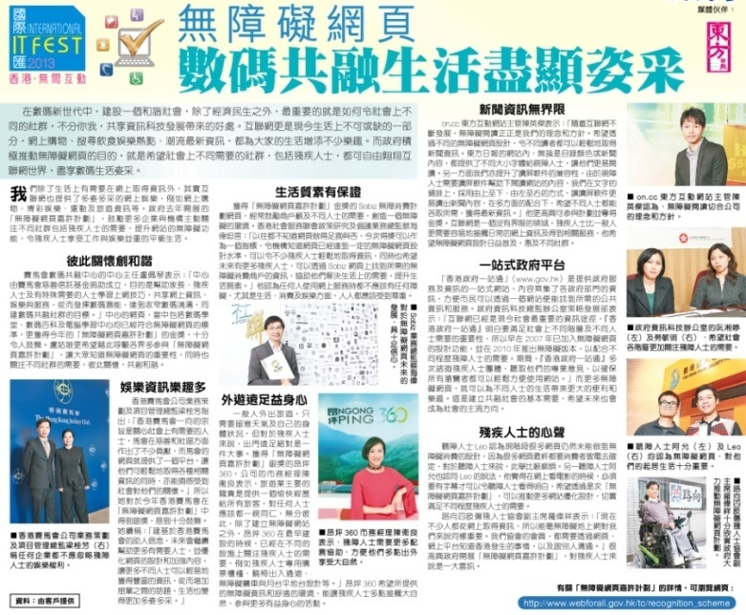
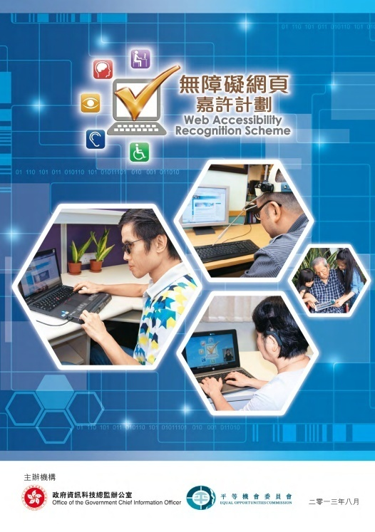
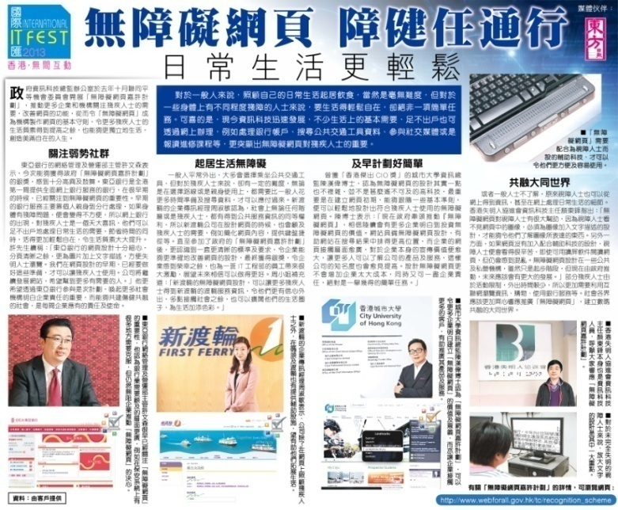
Web Accessibility Recognition Scheme
Advertorials and Booklet Insertion
via Newspaper

Slide 19
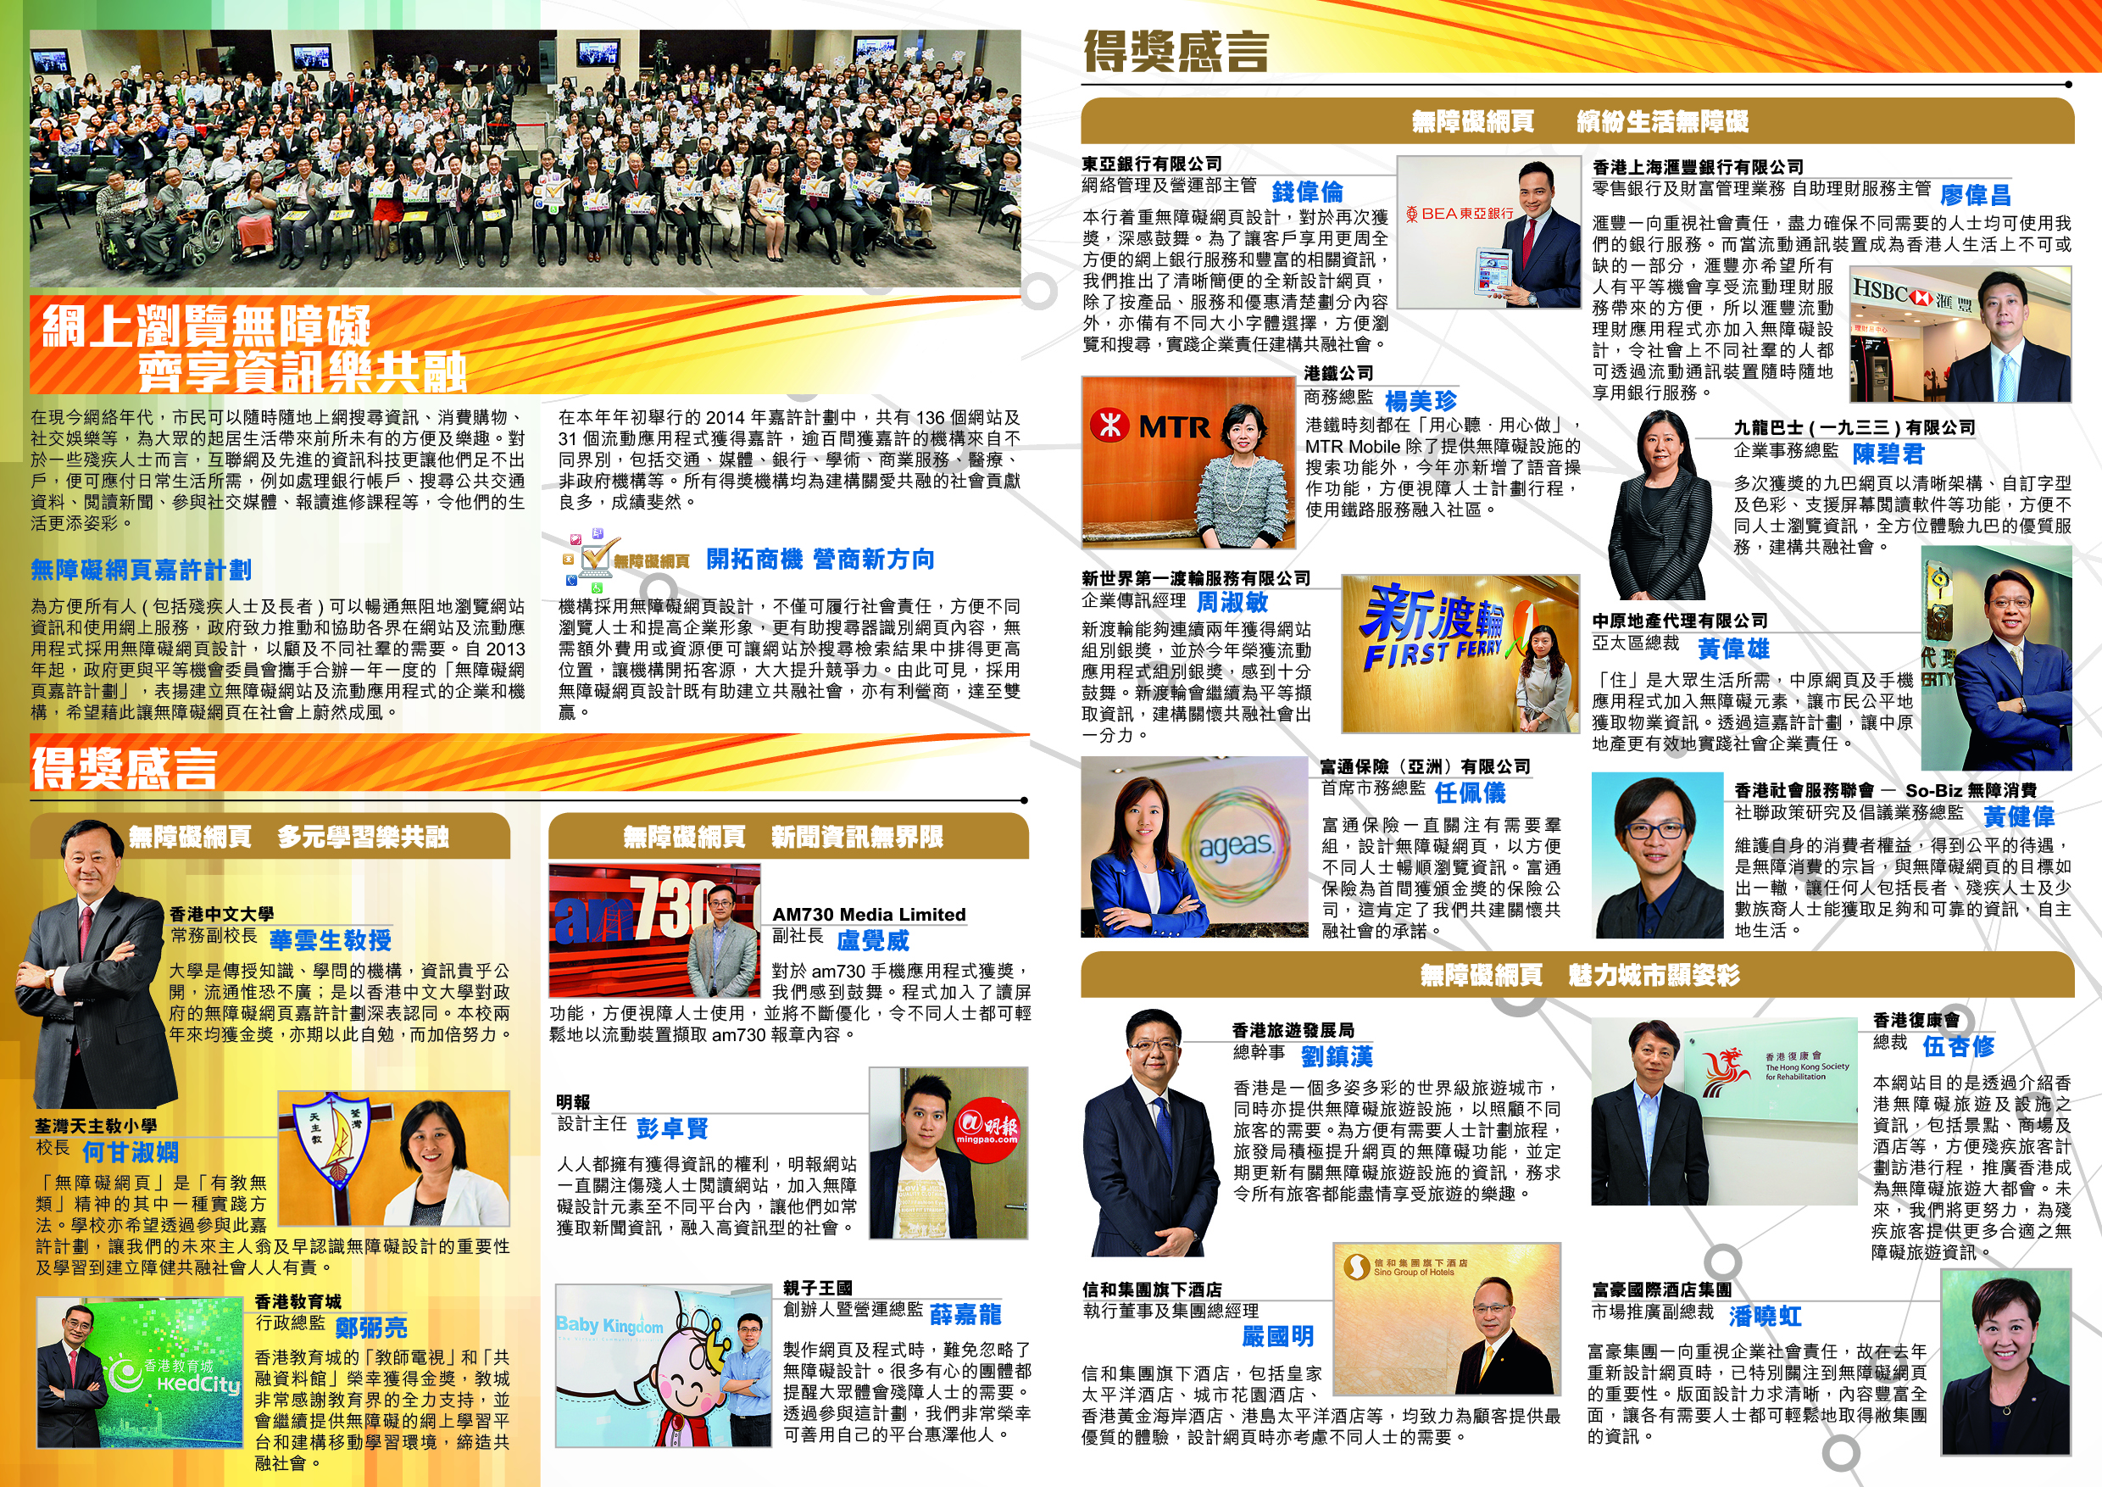
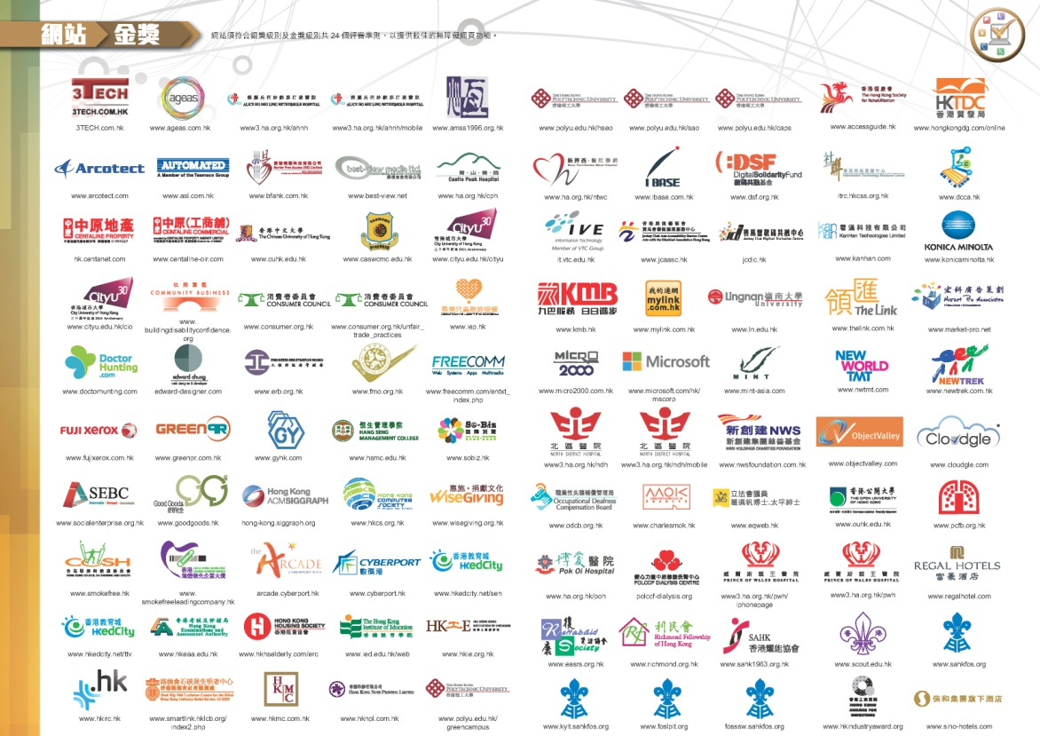
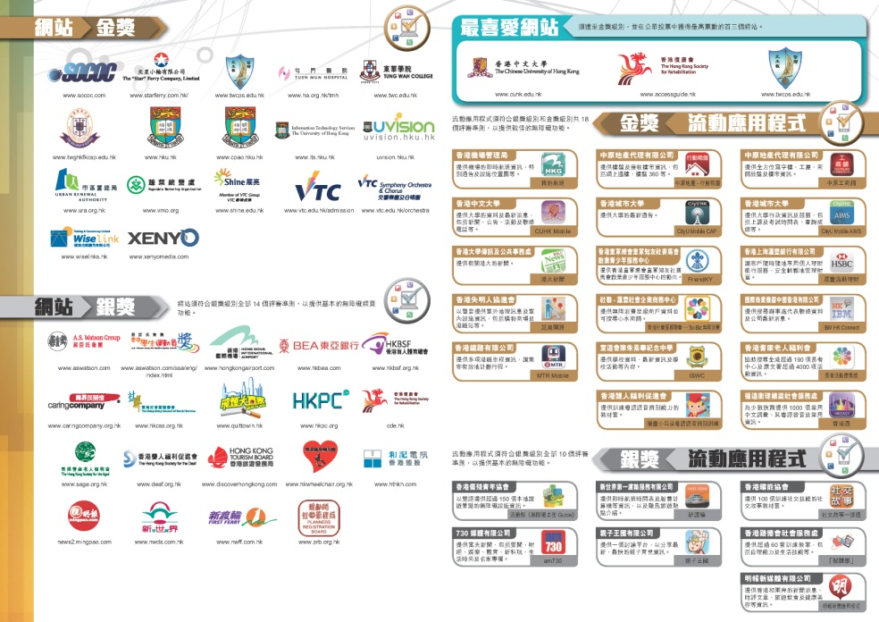
Web Accessibility Recognition Scheme
Awardees List and Advertorials in Newspapers and Magazine

Slide 20
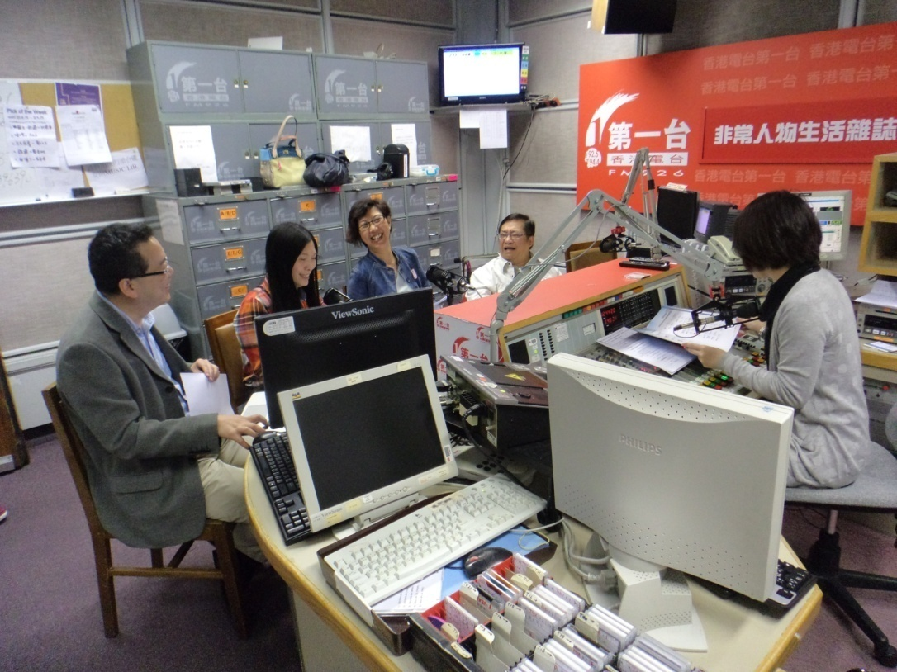
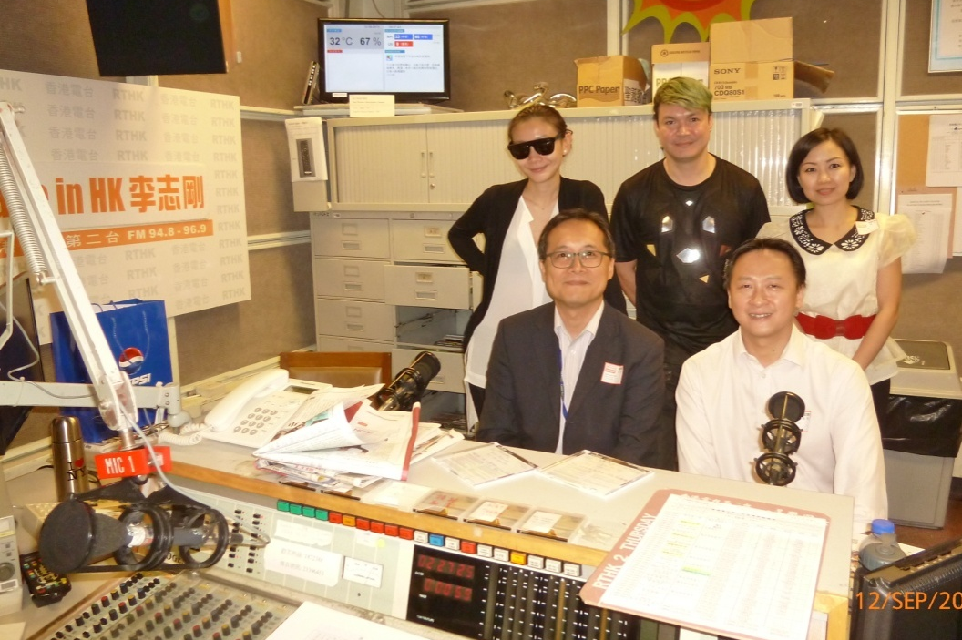
Web Accessibility Recognition Scheme
Radio Interviews

Slide 21
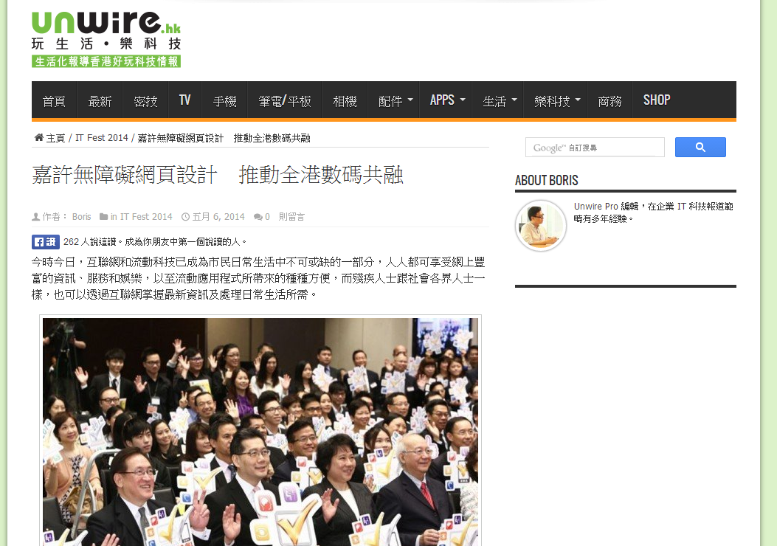
Web Accessibility Recognition Scheme
Awards Presentation Ceremony Highlight in Unwire Website

Slide 22
Web Accessibility Recognition Scheme 2014
Awards Presentation Ceremony
110
Organisations
136 Websites
31 Mobile Apps
3 Most Favourite Websites
117 Gold and 19 Silver
23 Gold and 8 Silver
Awards Presentation Ceremony of Web Accessibility Recognition Scheme 2014

Slide 23
Web Accessibility Recognition Scheme
Highlights of Awards Presentation Ceremony of the Web Accessibility Recognition Scheme 2014
www.ogcio.gov.hk/en/community/web_accessibility/recognition_scheme/2014/video/wars_video3.mp4

Slide 24
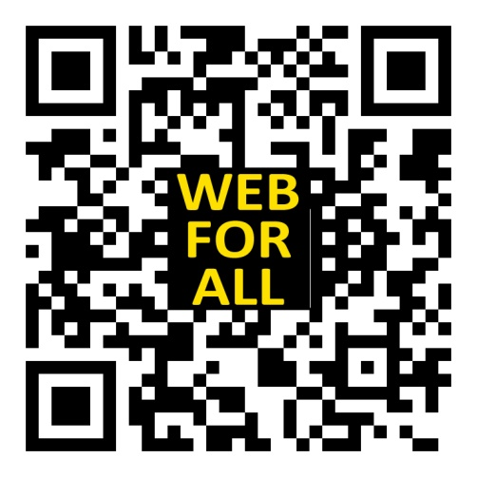
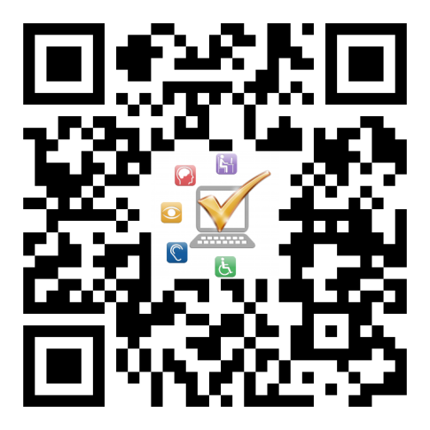
Thank you!
Web Accessibility Campaign Programme Office
Email : wac@ogcio.gov.hk
Tel. no. : 2582 4606
Web Accessibility Campaign
www.webforall.gov.hk
Web Accessibility Recognition Scheme
www.webforall.gov.hk/scheme

