Slide 1
Technical Aspects of Mobile App Accessibility
Office of the Government Chief Information Officer
Digital Inclusion Divison
27 June 2014

Slide 2
Agenda
Common Accessibility Pitfalls in Mobile Apps
How to Make Accessible Mobile Apps?
How to Conduct Accessibility Test for Mobile Apps?
Introduction to WAI-ARIA

Slide 3
Common Accessibility Pitfalls in Mobile Apps

Slide 4
Characteristics of Mobile Apps
Type of Mobile Apps
Native App
Hybrid App
Web App
Platforms
Android (Google)
iOS (Apple)
Windows Phone (Microsoft)
Blackberry
Source: Strategy Analytics

Slide 5
How Mobile Platform Support Accessibility
iOS 7 | Android 4.1
VoiceOver Siri Speak Selection Dictation Zoom Font Adjustments Invert Colors AssistiveTouch Close Caption | TalkBack Speak passwords Screen timeout Explore by touch Invert Colors Change font size Mono audio Tap and hold delay

Slide 6
How Mobile Platform Support Accessibility
Setting
iOS 7 | Android 4.1

Slide 7
Screen Readers
To identify and interpret what is being displayed on the screen
iOS: VoiceOver
Proprietary by Apple
Support multiple languages without need to install Text-to-Speech Engine
Android: TalkBack
Open source
Require to install custom Text-to-Speech Engine
(e.g. eSpeak Text-to-Speech engine for Cantonese)

Slide 8
Common Accessibility Pitfalls
Findings from Web Accessibility Recognition Scheme 2014
Silver Award ( Total 10 Judging criteria)
No text alternatives (100% Fail)
Not meaningful sequence (42% Fail)
Not compatible with screen reader (71% Fail)
Gold Award ( Total 8 Judging criteria)
Insufficient colour contrast (98% Fail)
No input assistance (40% Fail)

Slide 9
How to Make Accessible Mobile Apps?

Slide 10
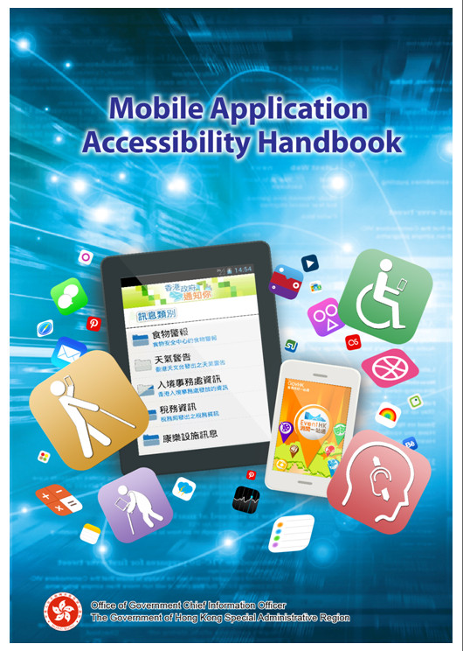
Steps to Build Accessible Mobile Apps
Step 1
Understand the accessibility requirements
Observe relevant guidelines (www.webforall.gov.hk)
Make reference to Mobile Application Accessibility Handbook
Step 2
Visual and Layout Review
Code Review

Slide 11
Steps to Build Accessible Mobile Apps (Con’t)
Step 3
Test your mobile apps
Visual Check
Manuel test with screen reader (e.g. VoiceOver and Talkback)
Step 4
Human testing (by persons with disabilities preferably)

Slide 12
How to Conduct Accessibility Test for Mobile Apps?

Slide 13
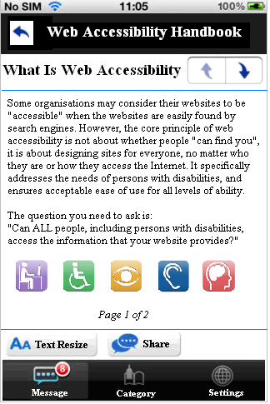
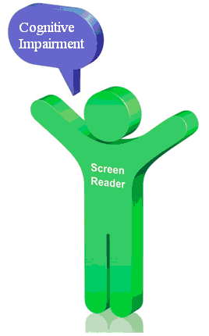
1. Alternate Text
No alternatives for non-text content
Persons with visual impairment cannot perceive the image content

Slide 14
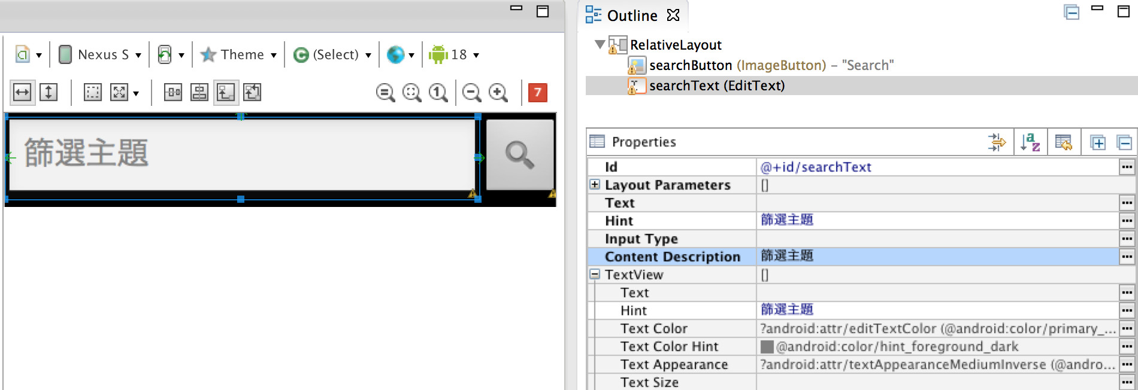
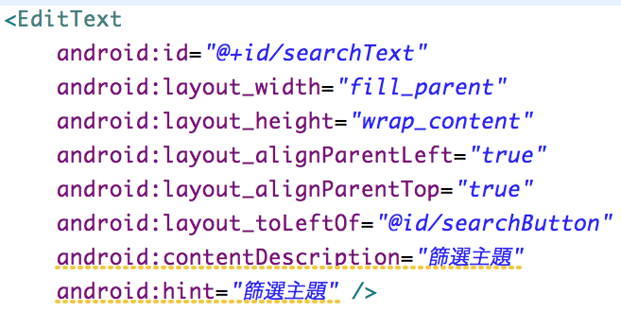
1. Alternate Text (Con’t)
Android :
Check Content Description in layout xml

Slide 15
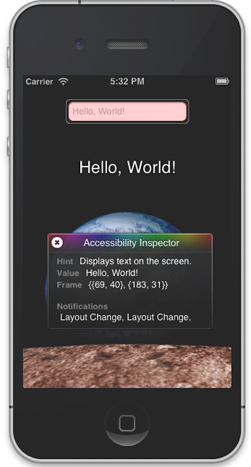
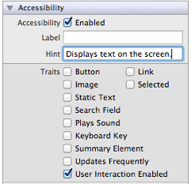
1. Alternate Text (Con’t)
iOS:
Enable Accessibility features (XCode)
VoiceOver users rely on the labels and hints to use the application

Slide 16
1. Alternate Text (Con’t)
Provide meaningful alternative text for non-text elements such as image, button, etc
Provide null alternative text for decorative image
Screen reader should read menu item / function block with "button" or "按鈕“
Alternative text should be consistency with user's language i.e. alternative text should not be in English for Chinese interface
Pay attention to date format. e.g. 2014年2月14日 is more meaningful than 2014/2/14
Voice Captcha available when turn on screen reader

Slide 17
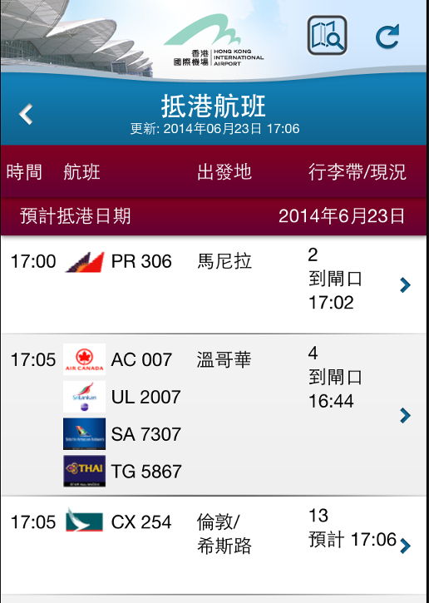
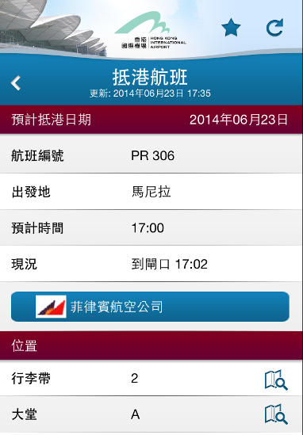
1. Alternate Text (Con’t)
Please listen to the audio first and get the meaning
Source : 我的航班

Slide 18
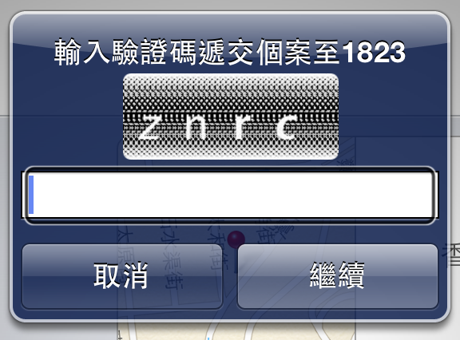
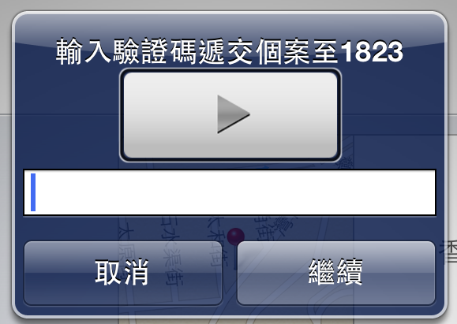
1. Alternate Text (Con’t)
Voice Captcha available when turn on screen reader
http://www.gov.hk/en/about/govdirectory/mobilesites.htm

Slide 19
2. Meaningful Sequence
Make sure the content is coded in a logical order
Screen reader should read important content first and then read other content/menu for every screen
Screen reader should read content from left to right and top to bottom
Pay attention to timetable with row and column
H2

Slide 20
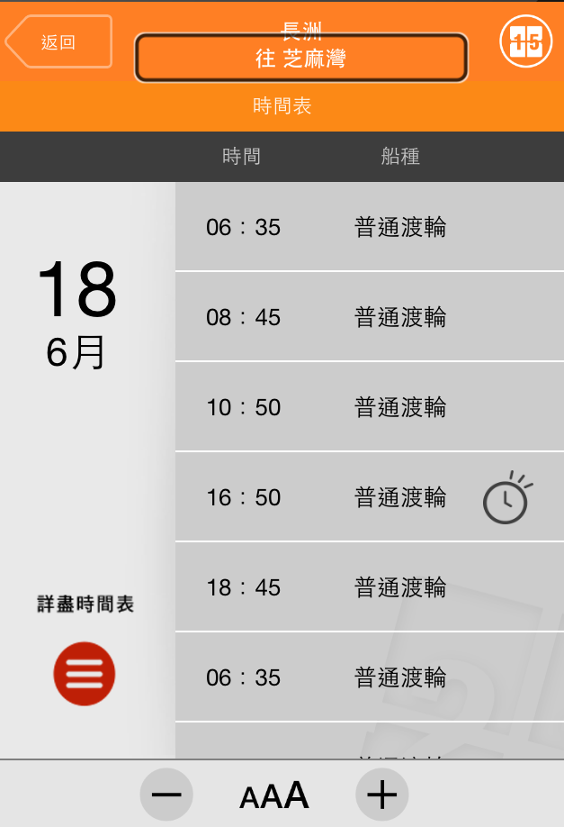
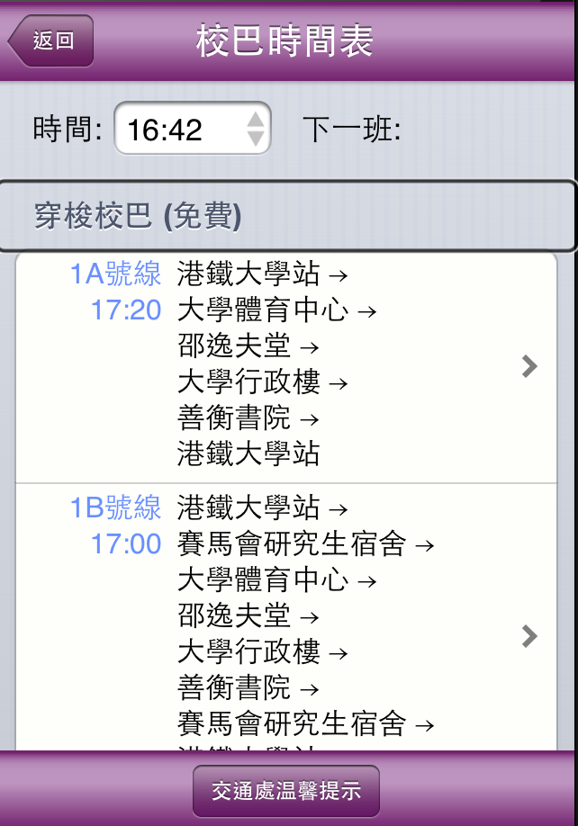
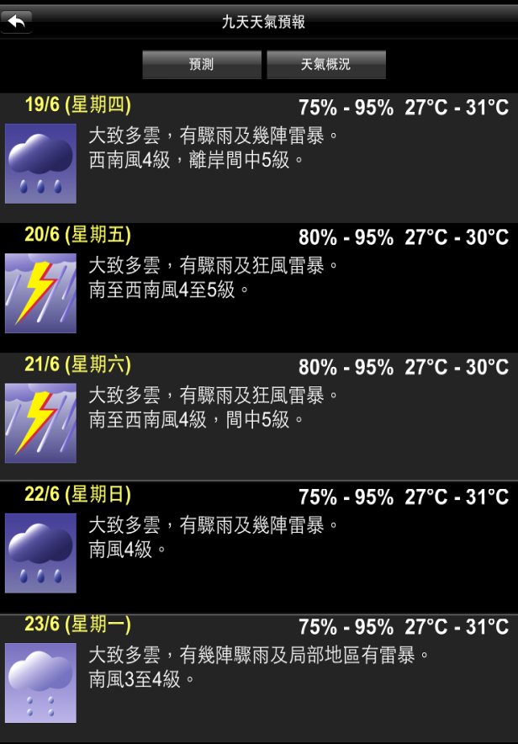
2. Meaningful Sequence (Con’t)
Testing: Manual Testing with Screen Reader
More examples:
H2
Source : First Ferry Mobile App
Source : CUHK Mobile App
Source : MyObservatory Mobile App

Slide 21
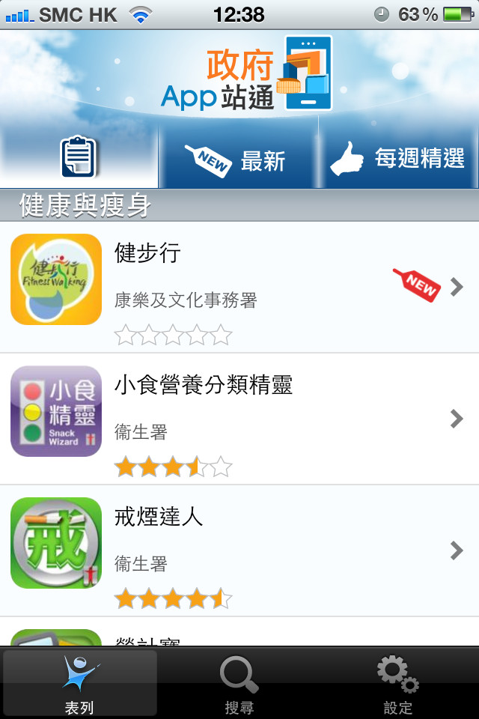
2. Meaningful Sequence (Con’t)
Testing: Manual Testing with Screen Reader
Screen reader reads the information from left to right, top to bottom sequences
Source : http://www.gov.hk/en/about/govdirectory/mobilesites.htm
H2

Slide 22
3. Not Compatible with Screen Reader
All contents, function, gesture are found in order when turning on screen reader
App should not crash when turn on screen reader
Maps ( such as Google Map or Apple Map) are not accessible with screen reader, alternate means of access should be provided
Alert message should be provided prior to access inaccessible items (e.g. Games )
H2

Slide 23
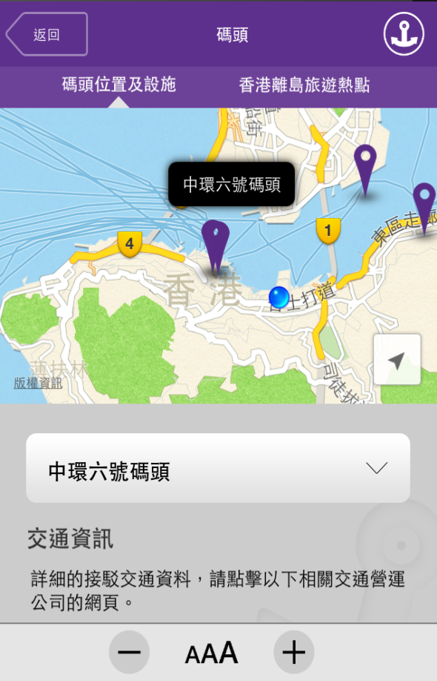
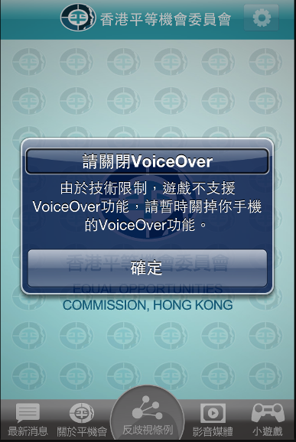
3. Not Compatible with Screen Reader (Con’t)
Selection menu provided to access location information
Alert box was pop up prior to access Mini Game
H2
Source : First Ferry Mobile App
Source : Equal Opportunities Commission Mobile App

Slide 24
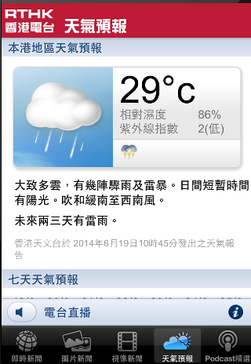
4. Sufficient Colour Contrast
Persons with low vision have difficulty reading text that does not contrast with its background
Compare color contrast between foreground and background
Normal text has a contrast ratio of at least 4.5:1
Contrast ratio can be reached by the system built-in Invert Colours function
Logo and brand name are exempted
Source : http://www.gov.hk/en/about/govdirectory/mobilesites.htm

Slide 25
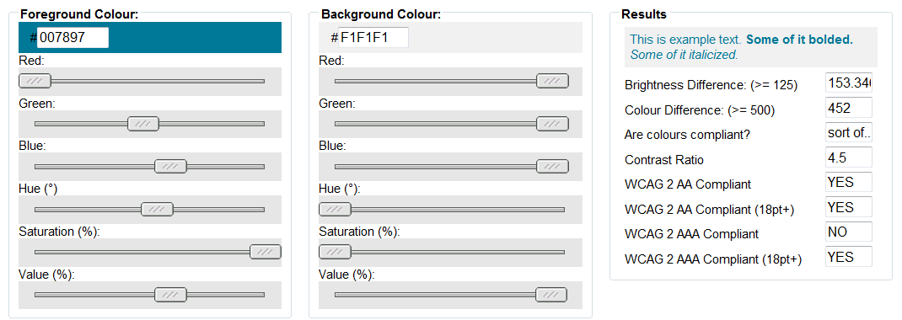
4. Sufficient Colour Contrast (Con’t)
Testing: Colour contrast check
http://snook.ca/technical/colour_contrast/colour.html

Slide 26
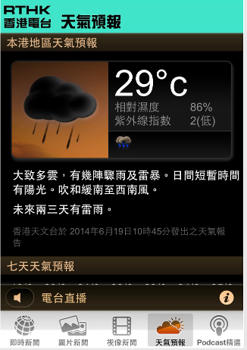
4. Sufficient Colour Contrast (Con’t)
Invert Color : Built-in application to convert text in white-on-black or negative colors, helps improve contrast
Source : http://www.gov.hk/en/about/govdirectory/mobilesites.htm

Slide 27
5. Input Assistance
Provide input assistance such as proper labels or instructions for user input
Screen reader can read the text description when focusing on the input components
Screen reader can read the selection box content when focusing on the input components

Slide 28
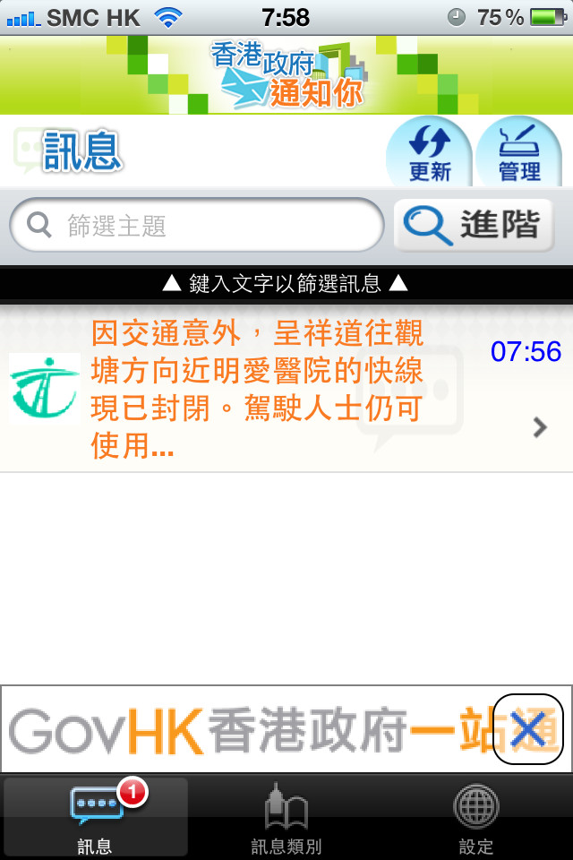
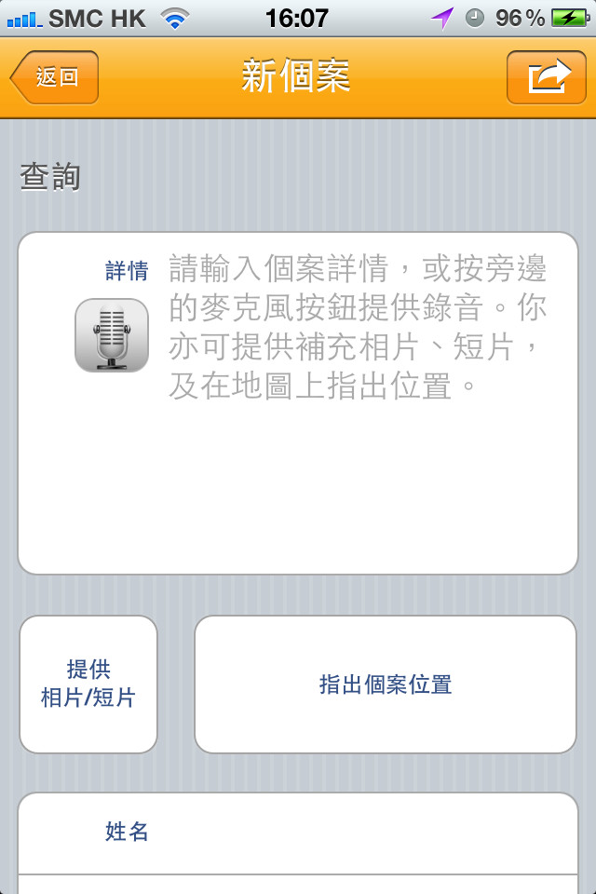
5. Input Assistance (Con’t)
Testing: Visual Review, Manual Testing with Screen Reader
Source : http://www.gov.hk/en/about/govdirectory/mobilesites.htm

Slide 29
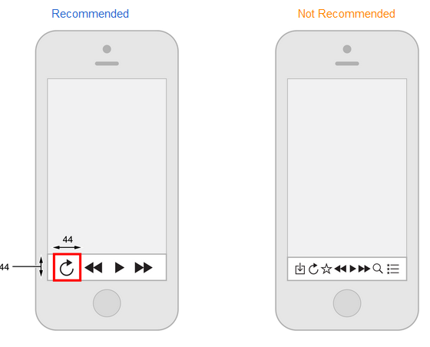
6. Clickable Object Size
Make all clickable objects large enough to be tapped
Android:
> 48 dp (approximately 9mm) in length and width. (http://developer.android.com/tools/testing/testing_accessibility.html)
iOS:
> 44 x 44 points. (https://developer.apple.com/library/ios/documentation/userexperience/conceptual/mobilehig/LayoutandAppearance.html)

Slide 30
6. Clickable Object Size (Con’t)
Testing: Visual Review and Screen Reader Test
Make all clickable objects large enough to be pressed.
Button and Links are large enough for tapping
Source : http://www.gov.hk/en/about/govdirectory/mobilesites.htm

Slide 31
7. Headings
Should provide heading in every screens as possible
Should not provide English headings for Chinese interface
Heading should be simple and avoid too long in length

Slide 32
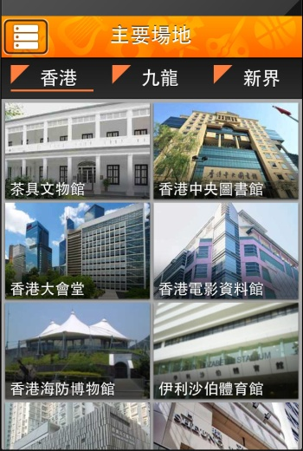
7. Headings (Con’t)
Testing: Visual Review, Manual Test with Screen Reader
Clear and simple headings
Source : http://www.gov.hk/en/about/govdirectory/mobilesites.htm

Slide 33
8. Structure and Content
Provide consistent and simple user interface structure
Consider in App Design Stage for common UI
Menu should be always placed at the top if possible
Menu should be always placed at the same place for different screens
Menu items should be the same order and same content for different screens

Slide 34
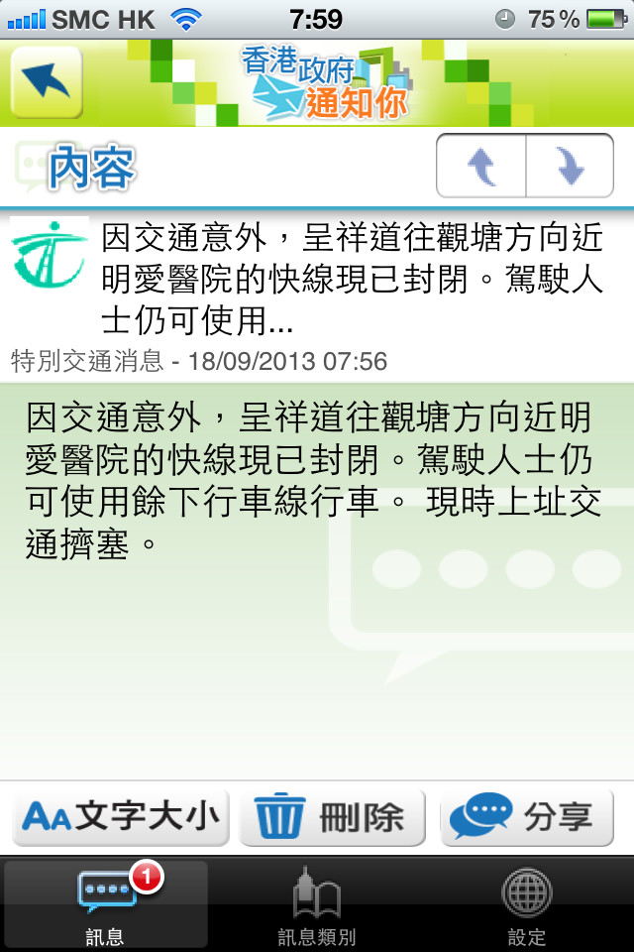
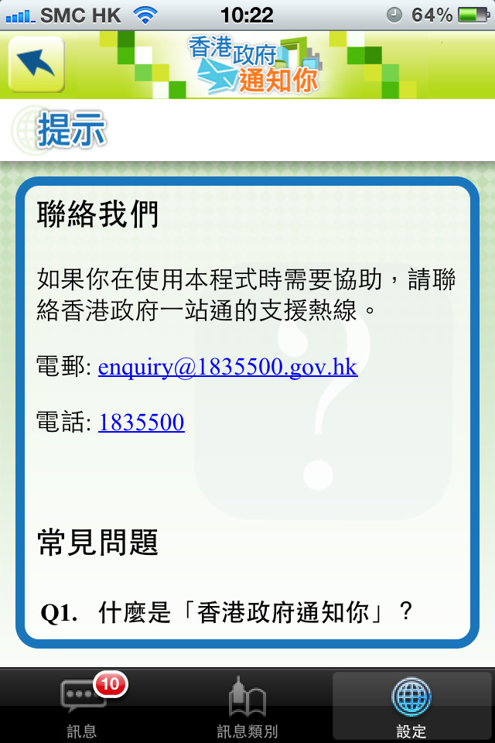
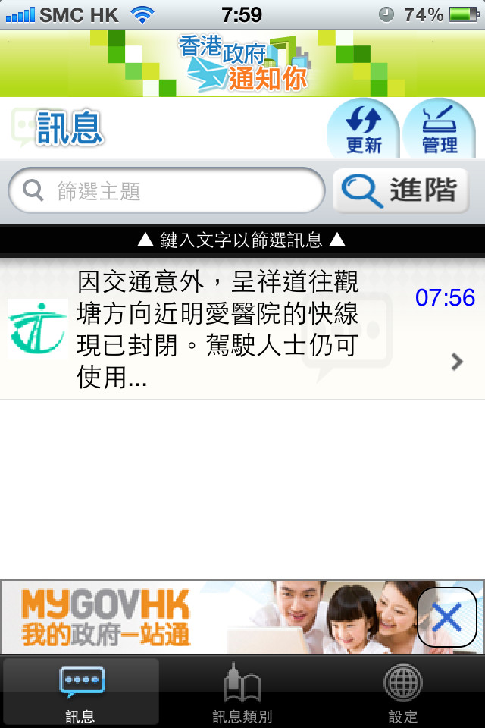
8. Structure and Content
Testing: Visual Review, Manual Test with Screen Reader
Source : http://www.gov.hk/en/about/govdirectory/mobilesites.htm

Slide 35
9. Navigation
Provide a button to go backward for hierarchy screens
Backward Button would be excluded in Android Platform
Provide a Done/Cancel button to close the current screen and then go backward

Slide 36
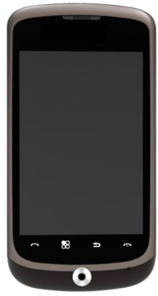
9. Navigation (Con’t)
Testing: Visual Review, Manual Test with Screen Reader
Some Android devices have hardware key with backward button
Source : http://www.gov.hk/en/about/govdirectory/mobilesites.htm

Slide 37
10. Text Resize
Text resize function or text can be zoomed without loss of content
Has enlarge function for text resize
Text resize function or text can be zoomed without loss of content
Content can be resized by the system built-in text resize function without lose of content

Slide 38
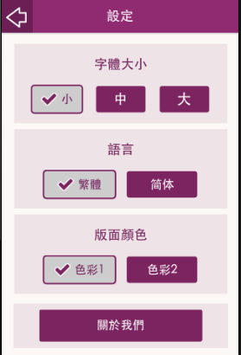
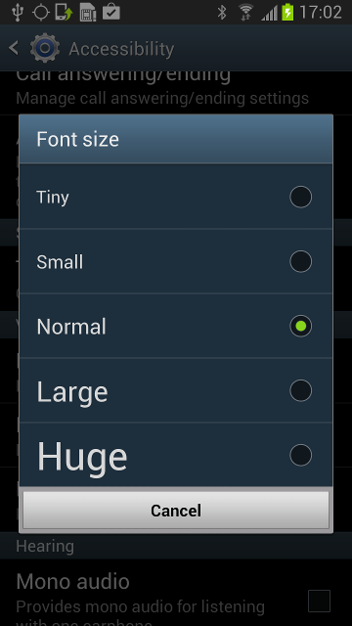
10. Text Resize (Con’t)
In App’s Setting
In System Setting

Slide 39
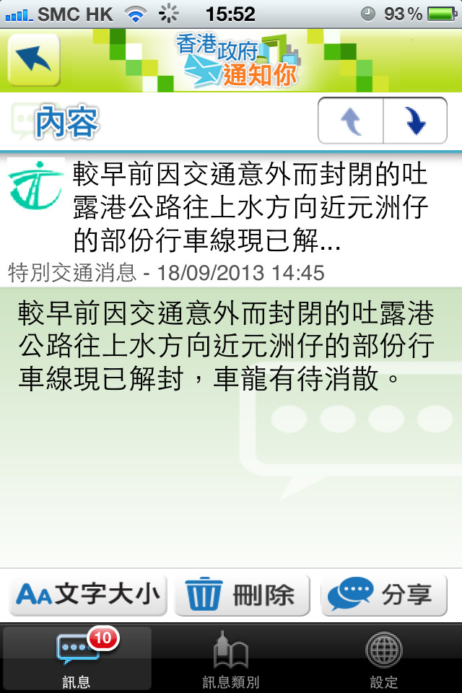
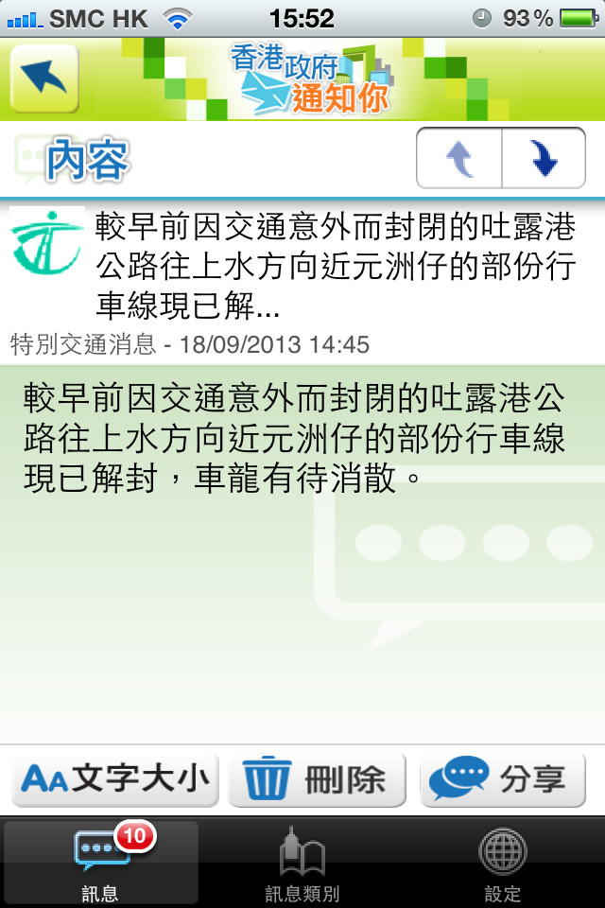
10. Text Resize (Con’t)
Testing: Visual Review and Human Testing
Text resize without loss of content
Source : http://www.gov.hk/en/about/govdirectory/mobilesites.htm

Slide 40
11. Video
Provide captions or sign language for pre-recorded videos
Provide caption
Provide sign language within videos
Provide text transcript

Slide 41
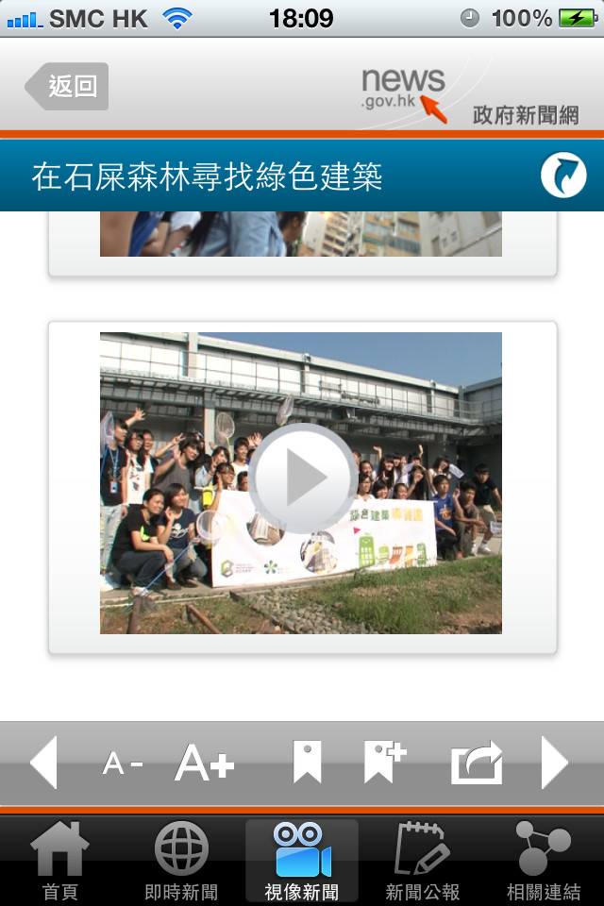
11. Video (Con’t)
Testing: Visual Review
Source : http://www.gov.hk/en/about/govdirectory/mobilesites.htm

Slide 42
12. Popovers
Provide means to close a popover screen.
Show close button with meaningful text alternative in popover windows
Pay attention to slash screens and advertising screens
Testing: Visual Review, Manual Testing with Screen Reader
Source : http://www.gov.hk/en/about/govdirectory/mobilesites.htm

Slide 43
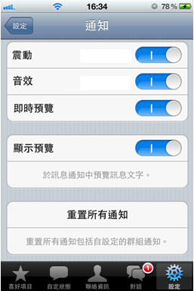
13. Alternate Means of Notification
“Vibrate” option notification should be provided
Persons with hearing impairment have difficulty to receive the alarm
Testing: Visual Review
Source : http://www.gov.hk/en/about/govdirectory/mobilesites.htm

Slide 44
14. Accessibility Statement
Provide contact points or email feedback as well as an accessibility statement in Contact us or About us screen
Samples:
English:
We have incorporated appropriate accessibility features in this app, if you still encounter difficulties in using this app, please contact us via email or phone.
Contact No : xxx xxxx
Email : xxx@xxx.xxx
Chinese:
本程式採用了無障礙設計。如在使用上有任何查詢或意見，請致電或發送電郵與我們聯絡。
電話號碼 : xxxx xxxx
電郵地址：xxx@xxx.xxx

Slide 45
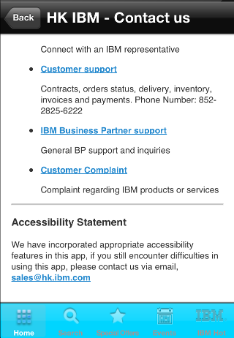
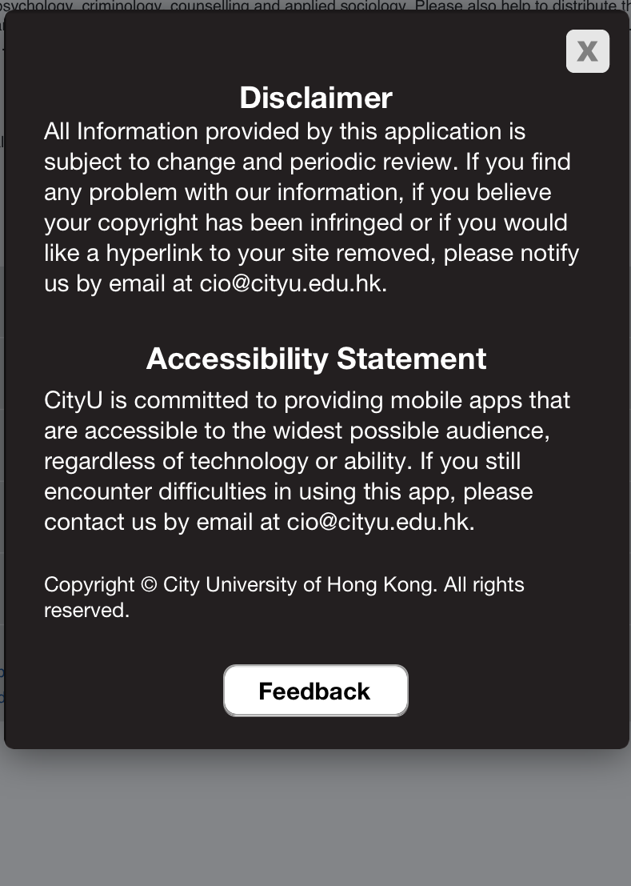
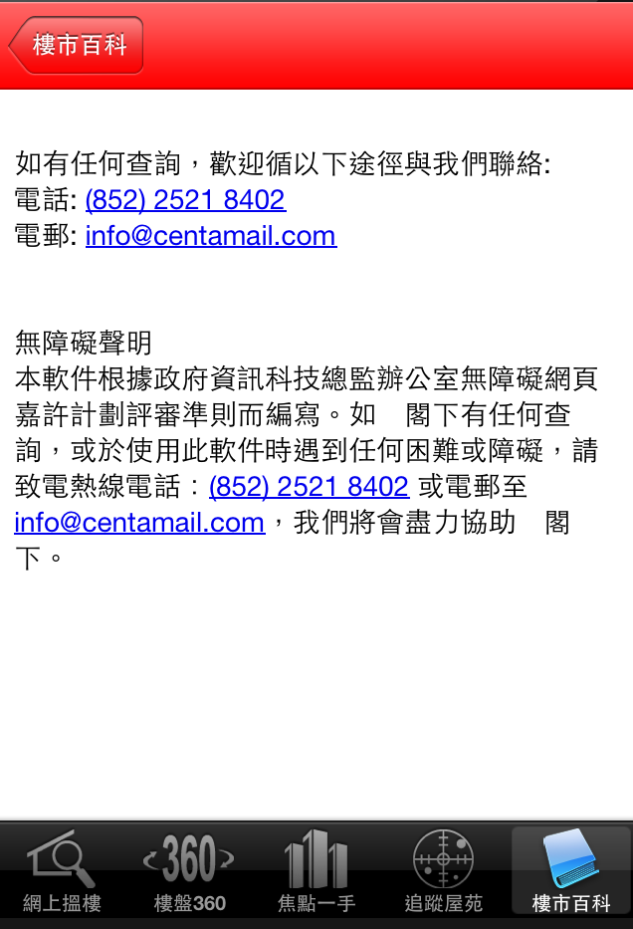
13. Accessibility Statement
Testing: Visual Review
Source : IBM HK Connect Mobile App
Source : City AMIS Mobile App
Source :中原地產 Mobile App

Slide 46
Development Frameworks
1) iOS (e.g. VoiceOver is proprietary and built-in)
http://developer.apple.com/technologies/ios/accessibility.html
Android (e.g. TalkBack or 3rd party solutions) http://developer.android.com/guide/topics/ui/accessibility/index.html
3) W3C Standards (mostly for browsers) WCAG 2.0
http://www.w3.org/TR/WCAG/
4) Mobile Web Best Practices 1.0
http://www.w3.org/TR/mobile-bp/
5) OGCIO Mobile Application Accessibility Handbook http://www.ogcio.gov.hk/en/community/web_accessibility/maahandbook/
➢No industry standards for native apps (yet)

Slide 47
Introduction to WAI-ARIA

Slide 48
Introduction to WAI-ARIA
WAI-ARIA
Stand for “Web Accessibility Initiative – Accessible Rich Internet Applications”
W3C announced version 1.0 on 20 March 2014
Set of attributes to help enhance the semantics of a web site or web application to help assistive technologies, such as screen readers for the blind
Part of HTML5
Affect Web App and Hybrid App
WAI-ARIA contains Roles, States and Properties
Source : www.w3.org/TR/wai-aria

Slide 49
Introduction to WAI-ARIA (Con’t)
Browsers support WAI-ARIA
Source: caniuse.com

Slide 50
Introduction to WAI-ARIA (Con’t)
Resource and examples
W3C WAI-ARIA
http://www.w3.org/TR/wai-aria/
Accessible jQuery-ui Components Demonstration
http://hanshillen.github.io/jqtest/#goto_slider
ARIA Examples
http://test.cita.illinois.edu/aria/index.php

Slide 51
Thank you!
Web Accessibility Campaign Programme Office
Email : wac@ogcio.gov.hk
Tel. no. : 2582 4606

